Slide 1
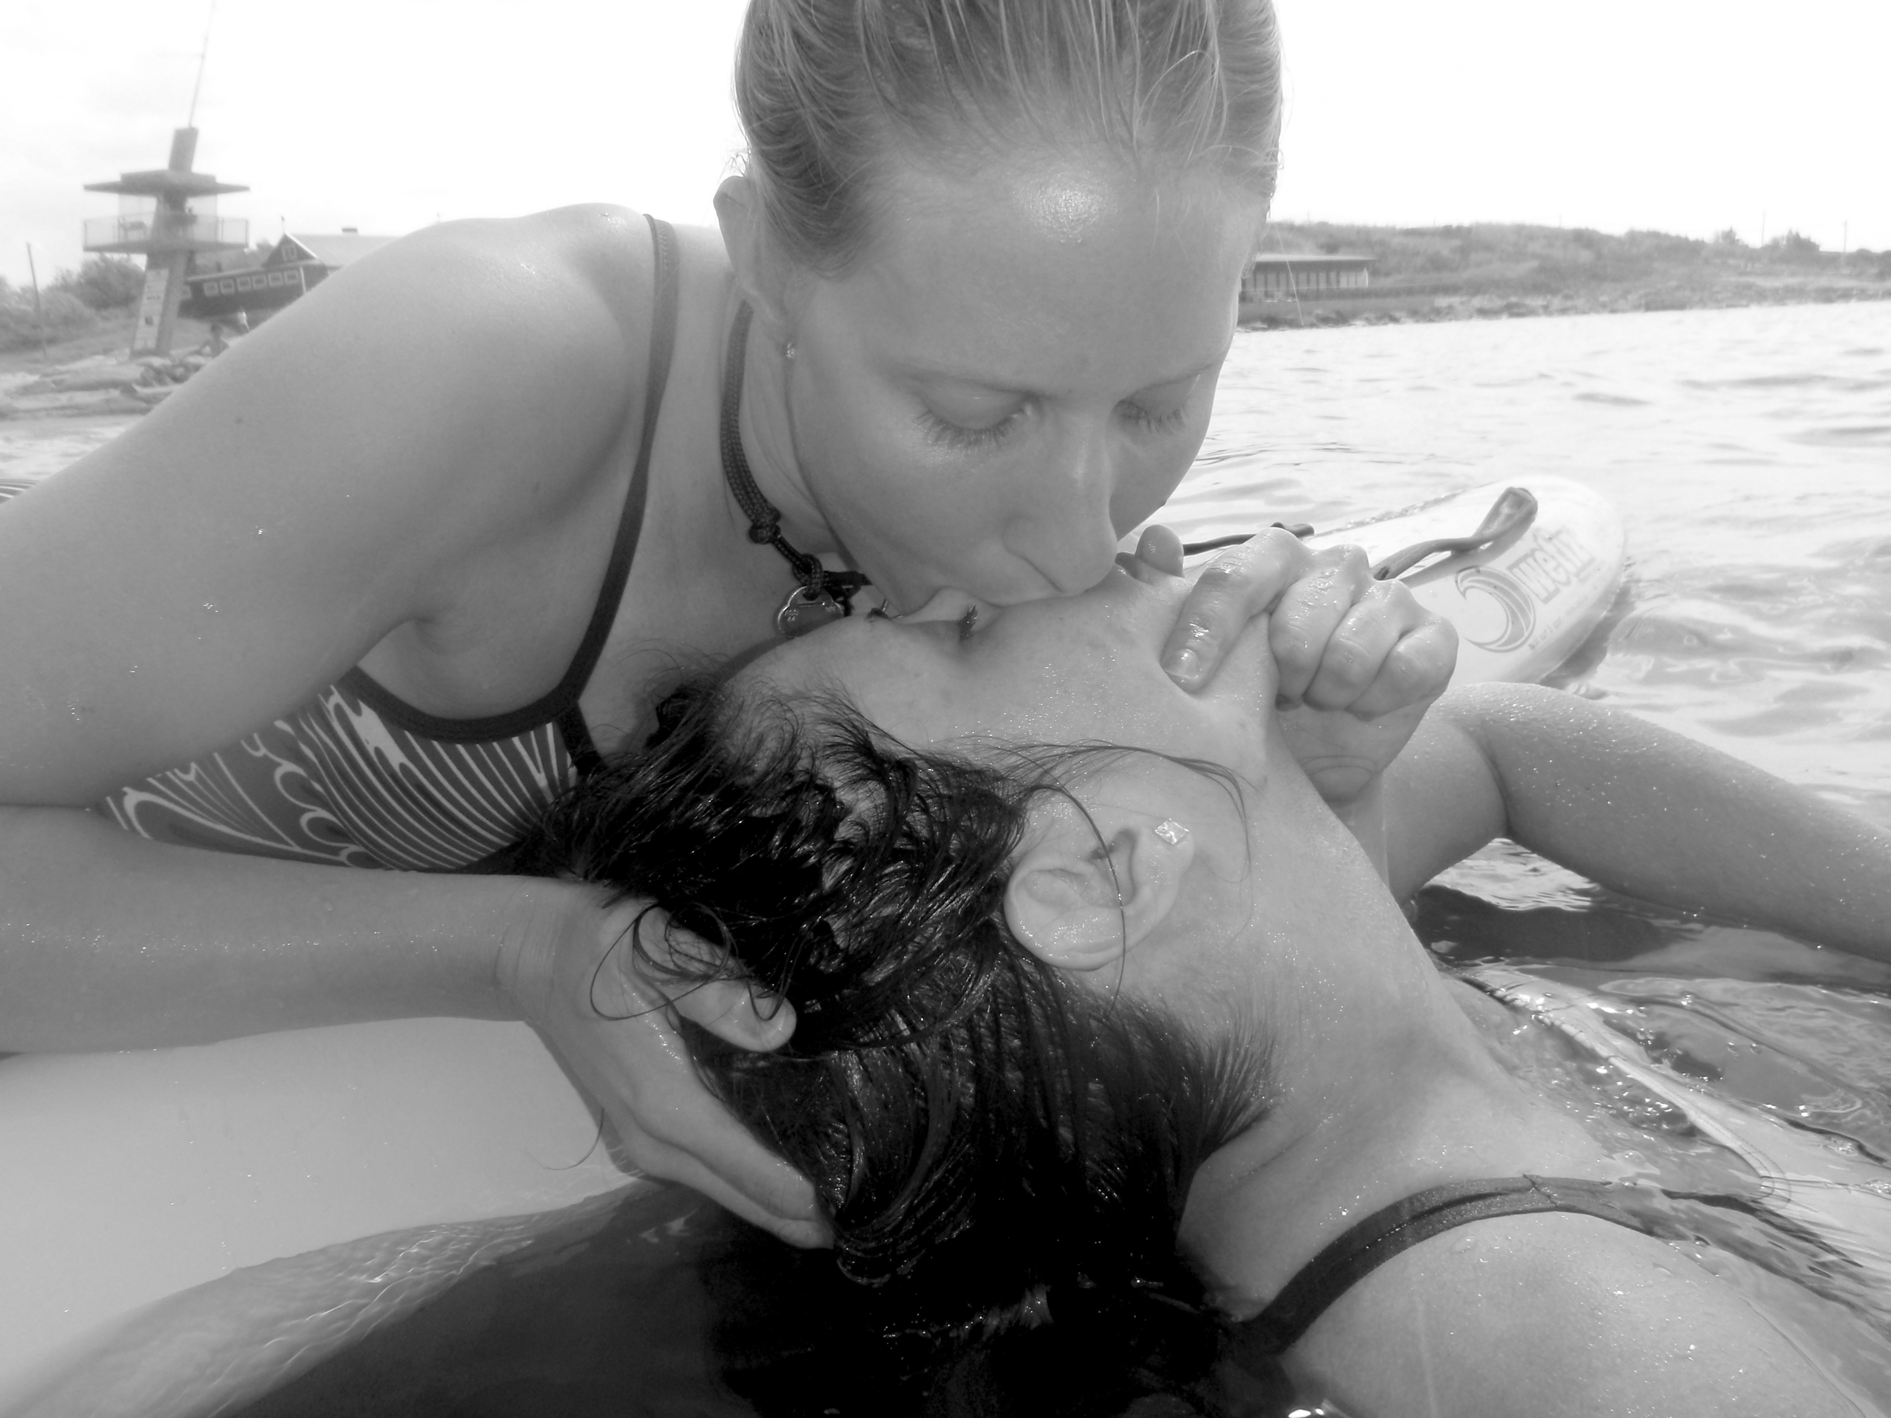
New BLS - drowning algorithm
- Swedish CPR council 2013
Andreas Claesson
Paramedic, RN/PhD
HLR2014 - Om Drunkning Tylösand 3-4 juni 2014

Slide 2
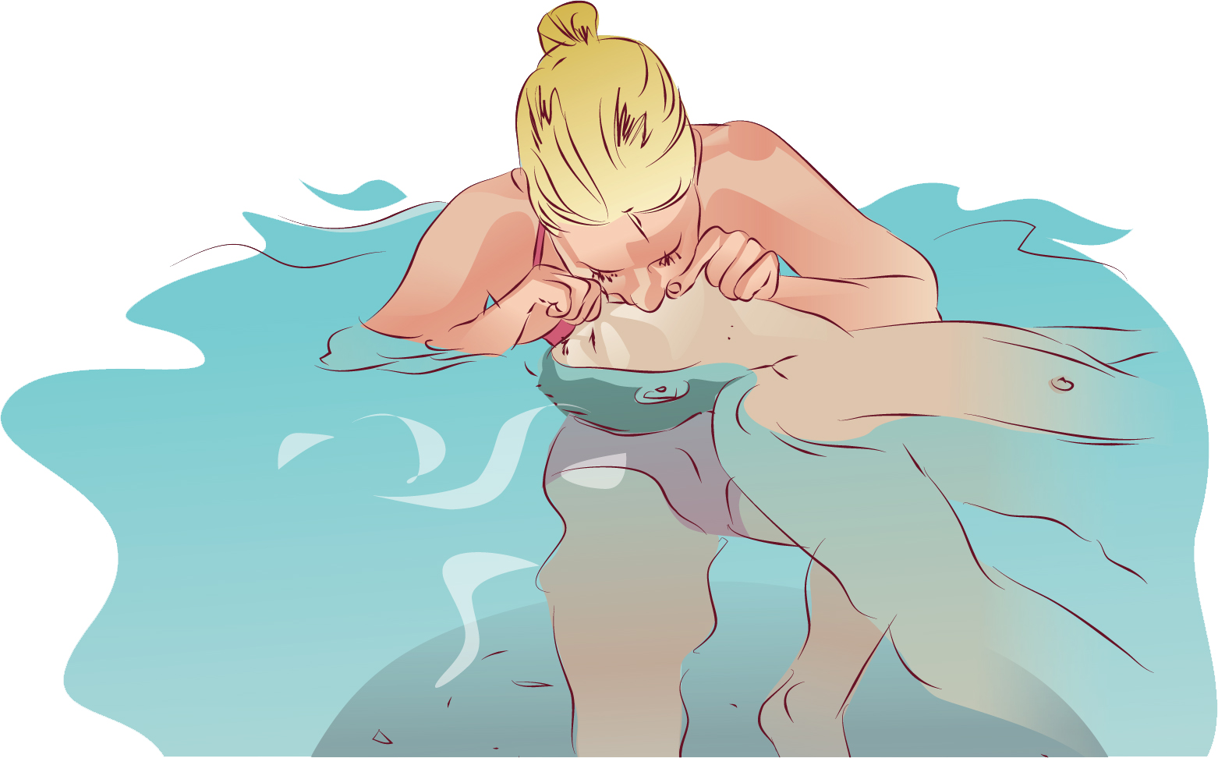
4 interrelated phases
i) Aquatic rescue
ii) Basic life support (BLS)
iii) Advanced life support (ALS)
iv) Post-resuscitation care
Soar J, Perkins GD, Abbas G, Alfonzo A, Barelli A, Bierens JJ, et al.
European Resuscitation Council Guidelines for Resuscitation 2010
electrocution. Resuscitation. 2010 Oct;81(10):1400-33.
HLR2014 - Om Drunkning Tylösand 3-4 juni 2014
Notes:
1.Viktigt med egna säkerheten
2. Många hypoterma, LUCAS kan vara en intervention för att kunna transportera med god HLR kvalitet

Slide 3
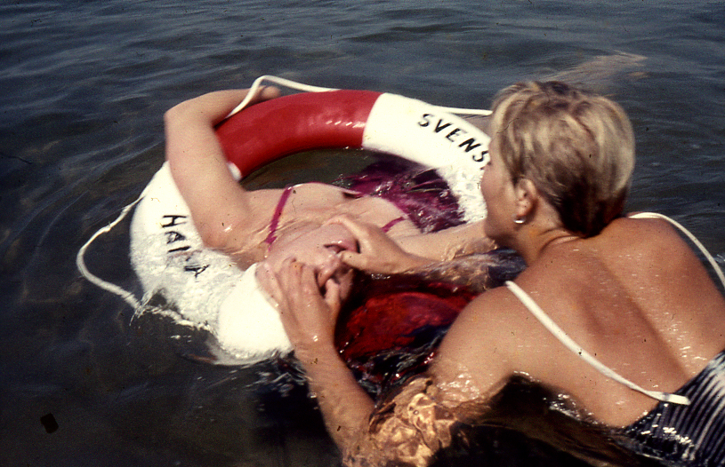

Slide 4
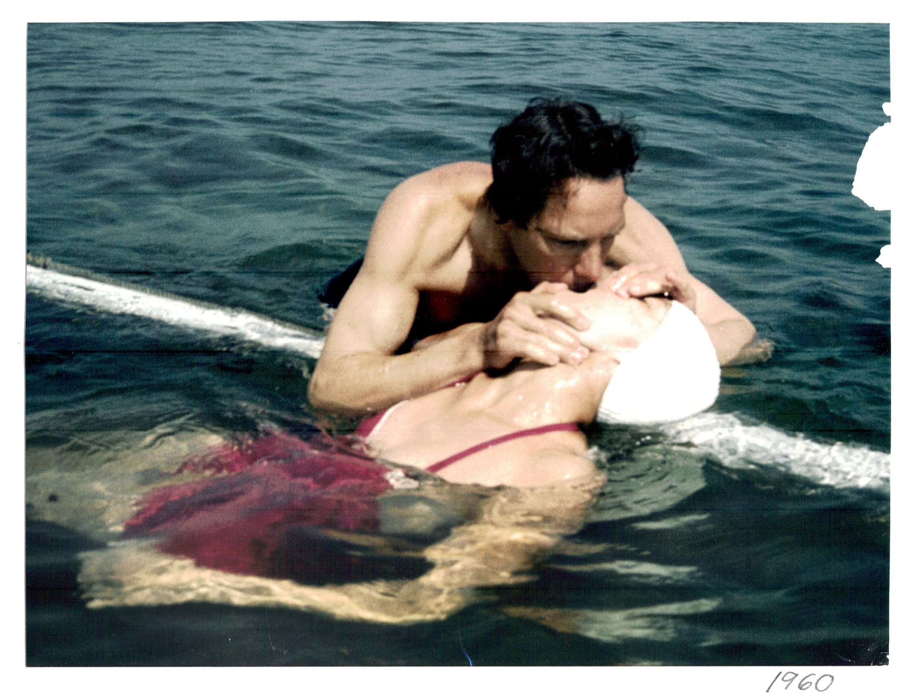

Slide 5
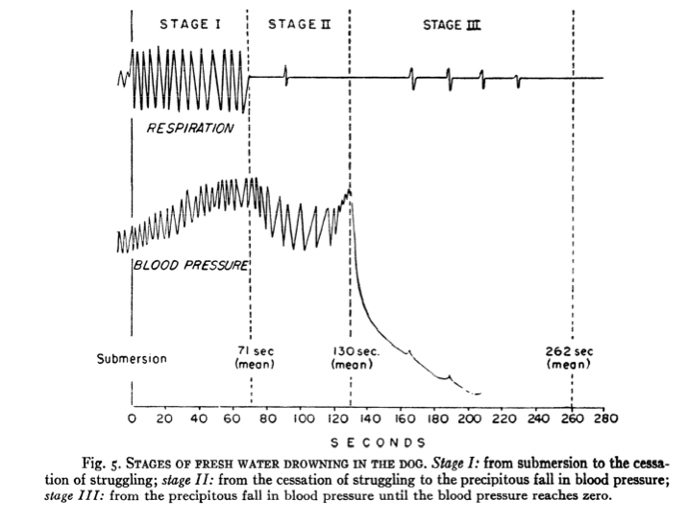
Fainer, Journal appl. phys. 1951
HLR2014 - Om Drunkning Tylösand 3-4 juni 2014
Notes:
5

Slide 6
ERC guidelines 2010
Alleviation of hypoxemia is the most important priority
Prompt initiation of rescue breathing or positive pressure ventilation and continous CPR increases survival
Five rescue breaths can be initiated already in shallow water provided the rescuers safety is not compromised
If the victim is in deep water, give 10–15 rescue breaths over approximately 1 min. Requires training and buoyancy aid!
Soar J, Perkins GD, Abbas G, Alfonzo A, Barelli A, Bierens JJ, et al.
European Resuscitation Council Guidelines for Resuscitation 2010
electrocution. Resuscitation. 2010 Oct;81(10):1400-33.
HLR2014 - Om Drunkning Tylösand 3-4 juni 2014
Notes:
1.Viktigt med egna säkerheten
2. Många hypoterma, LUCAS kan vara en intervention för att kunna transportera med god HLR kvalitet

Slide 7
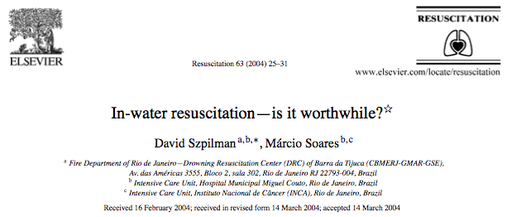
HLR2014 - Om Drunkning Tylösand 3-4 juni 2014
Notes:
7

Slide 8
Survival without sequele
In-water ventilation, NON-in water ventilation
n=19 n=27
52.6 % 7.4 %, P < 0.001
Szpilman, Resuscitation 63 (2004) 25-31
HLR2014 - Om Drunkning Tylösand 3-4 juni 2014
Notes:
8

Slide 9
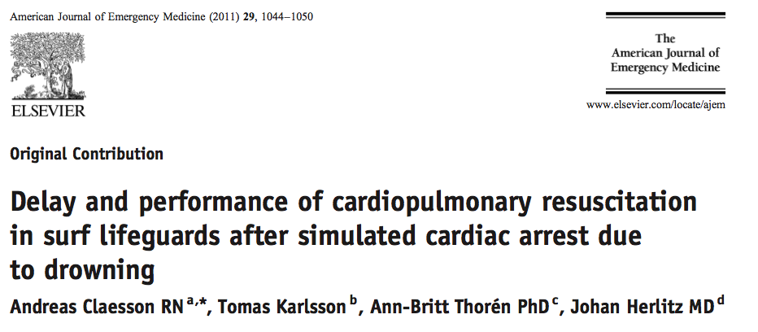
HLR2014 - Om Drunkning Tylösand 3-4 juni 2014
Notes:
9

Slide 10
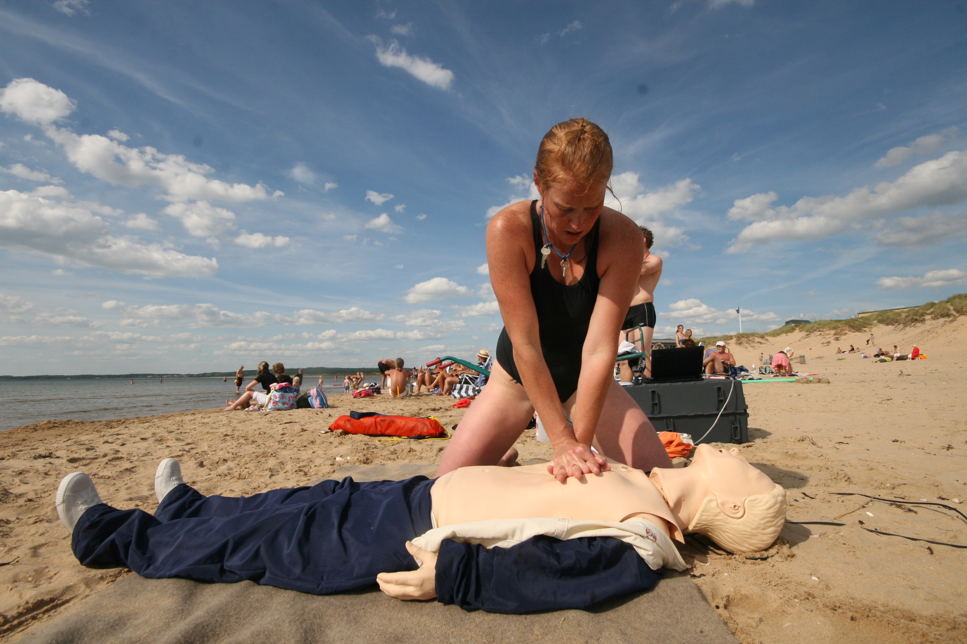
Surf rescue simulation
Test 1
CPR10 minutes (single rescuer - manikin)
Test 2
Surf rescue of 80 kg victim 100 m from shore + CPR10 minutes (single rescuer – manikin)
HLR2014 - Om Drunkning Tylösand 3-4 juni 2014

Slide 11
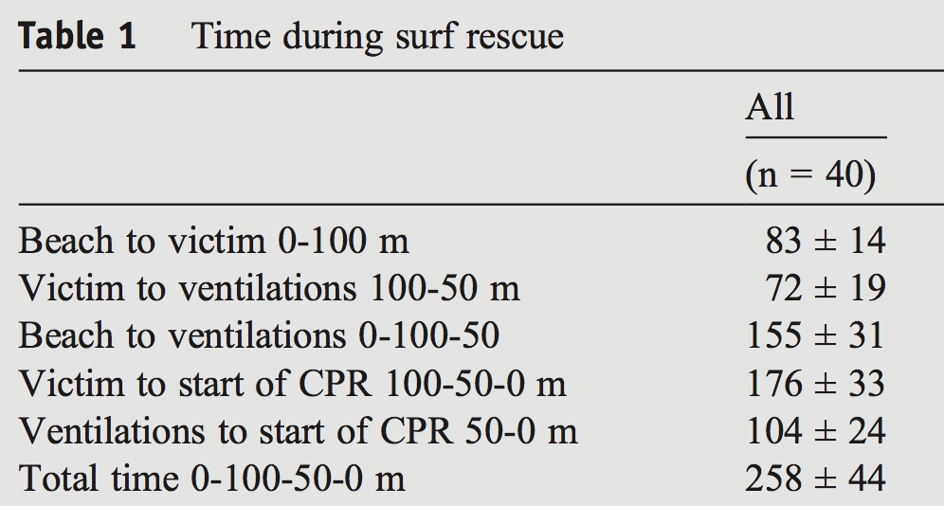
Delay to in-water ventilation
1,23 min
2,25 min
4,18 min
HLR2014 - Om Drunkning Tylösand 3-4 juni 2014
Notes:
11

Slide 12
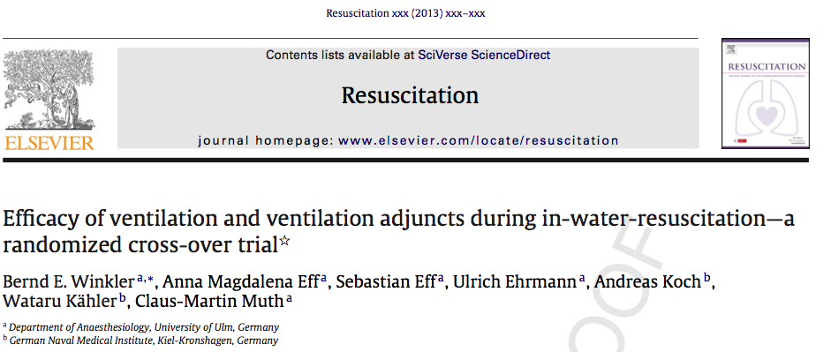
HLR2014 - Om Drunkning Tylösand 3-4 juni 2014

Slide 13
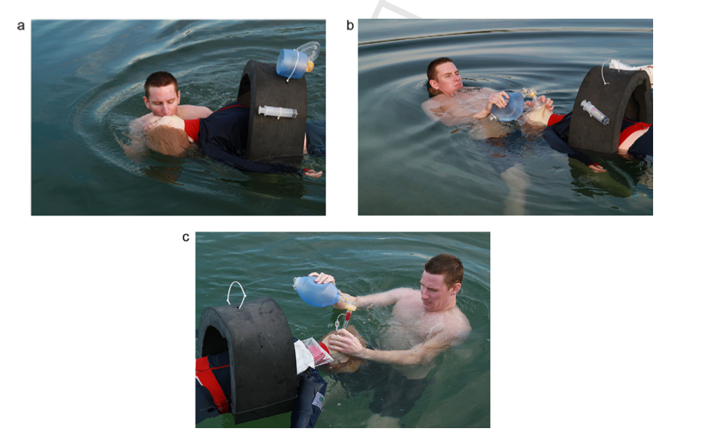
HLR2014 - Om Drunkning Tylösand 3-4 juni 2014

Slide 14
ERC guidelines 2010
Open the airway and check for breathing
Give 5 ventilations in shallow water if possible
Give 10-15 ventilations during 1 minute in deep water if trained to do so.
Mouth to nose ventilation is an alternative
- Very high inflation pressures may be required ca 35-40 cm H2O
Regurgitation of stomach contents is common
Abdominal thrusts can cause regurgitation and should not be used.
Continue with CPR 30:2 on firm ground until ALS or signs of life appears. - Use an AED if available.
Dry the victims chest before application of electrodes
Soar J, Perkins GD, Abbas G, Alfonzo A, Barelli A, Bierens JJ, et al.
European Resuscitation Council Guidelines for Resuscitation 2010
electrocution. Resuscitation. 2010 Oct;81(10):1400-33.
HLR2014 - Om Drunkning Tylösand 3-4 juni 2014
Notes:
1.Viktigt med egna säkerheten
2. Många hypoterma, LUCAS kan vara en intervention för att kunna transportera med god HLR kvalitet

Slide 15
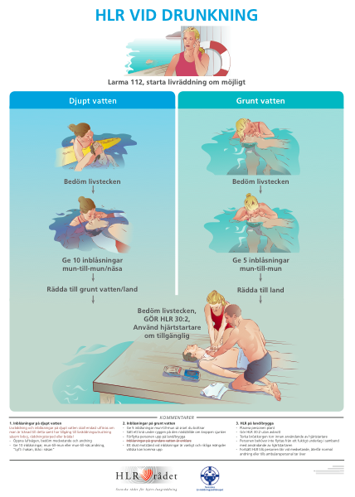


HLR2014 - Om Drunkning Tylösand 3-4 juni 2014

Slide 16
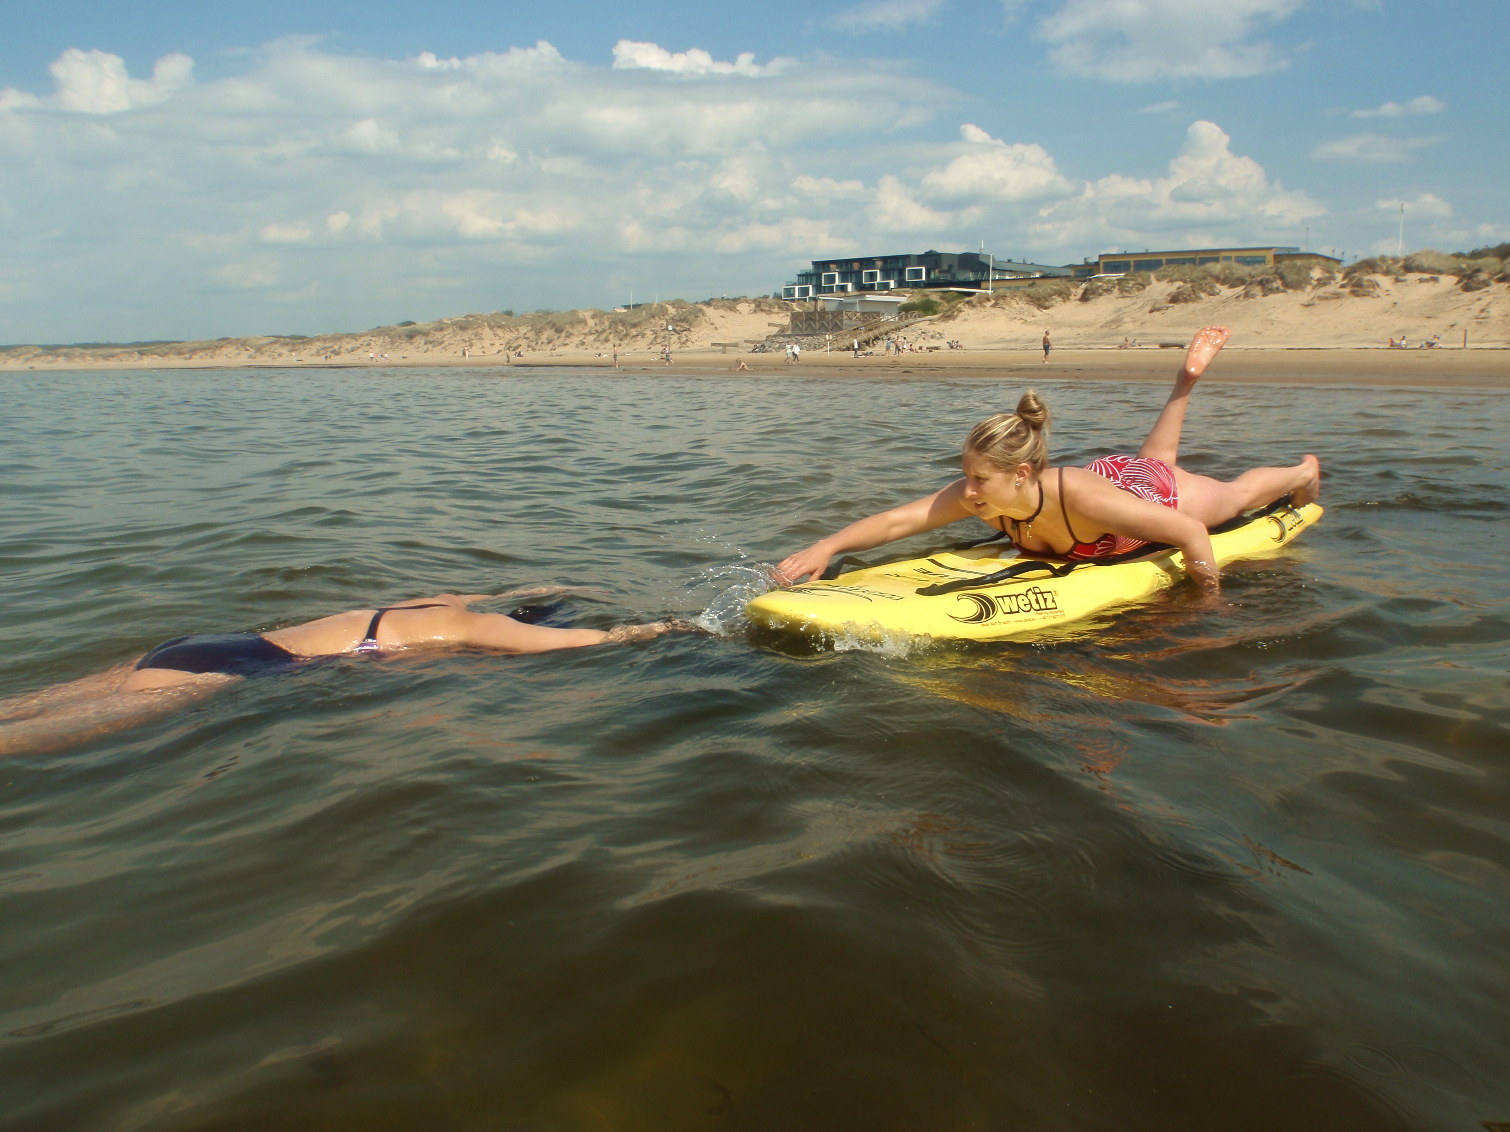

Slide 17
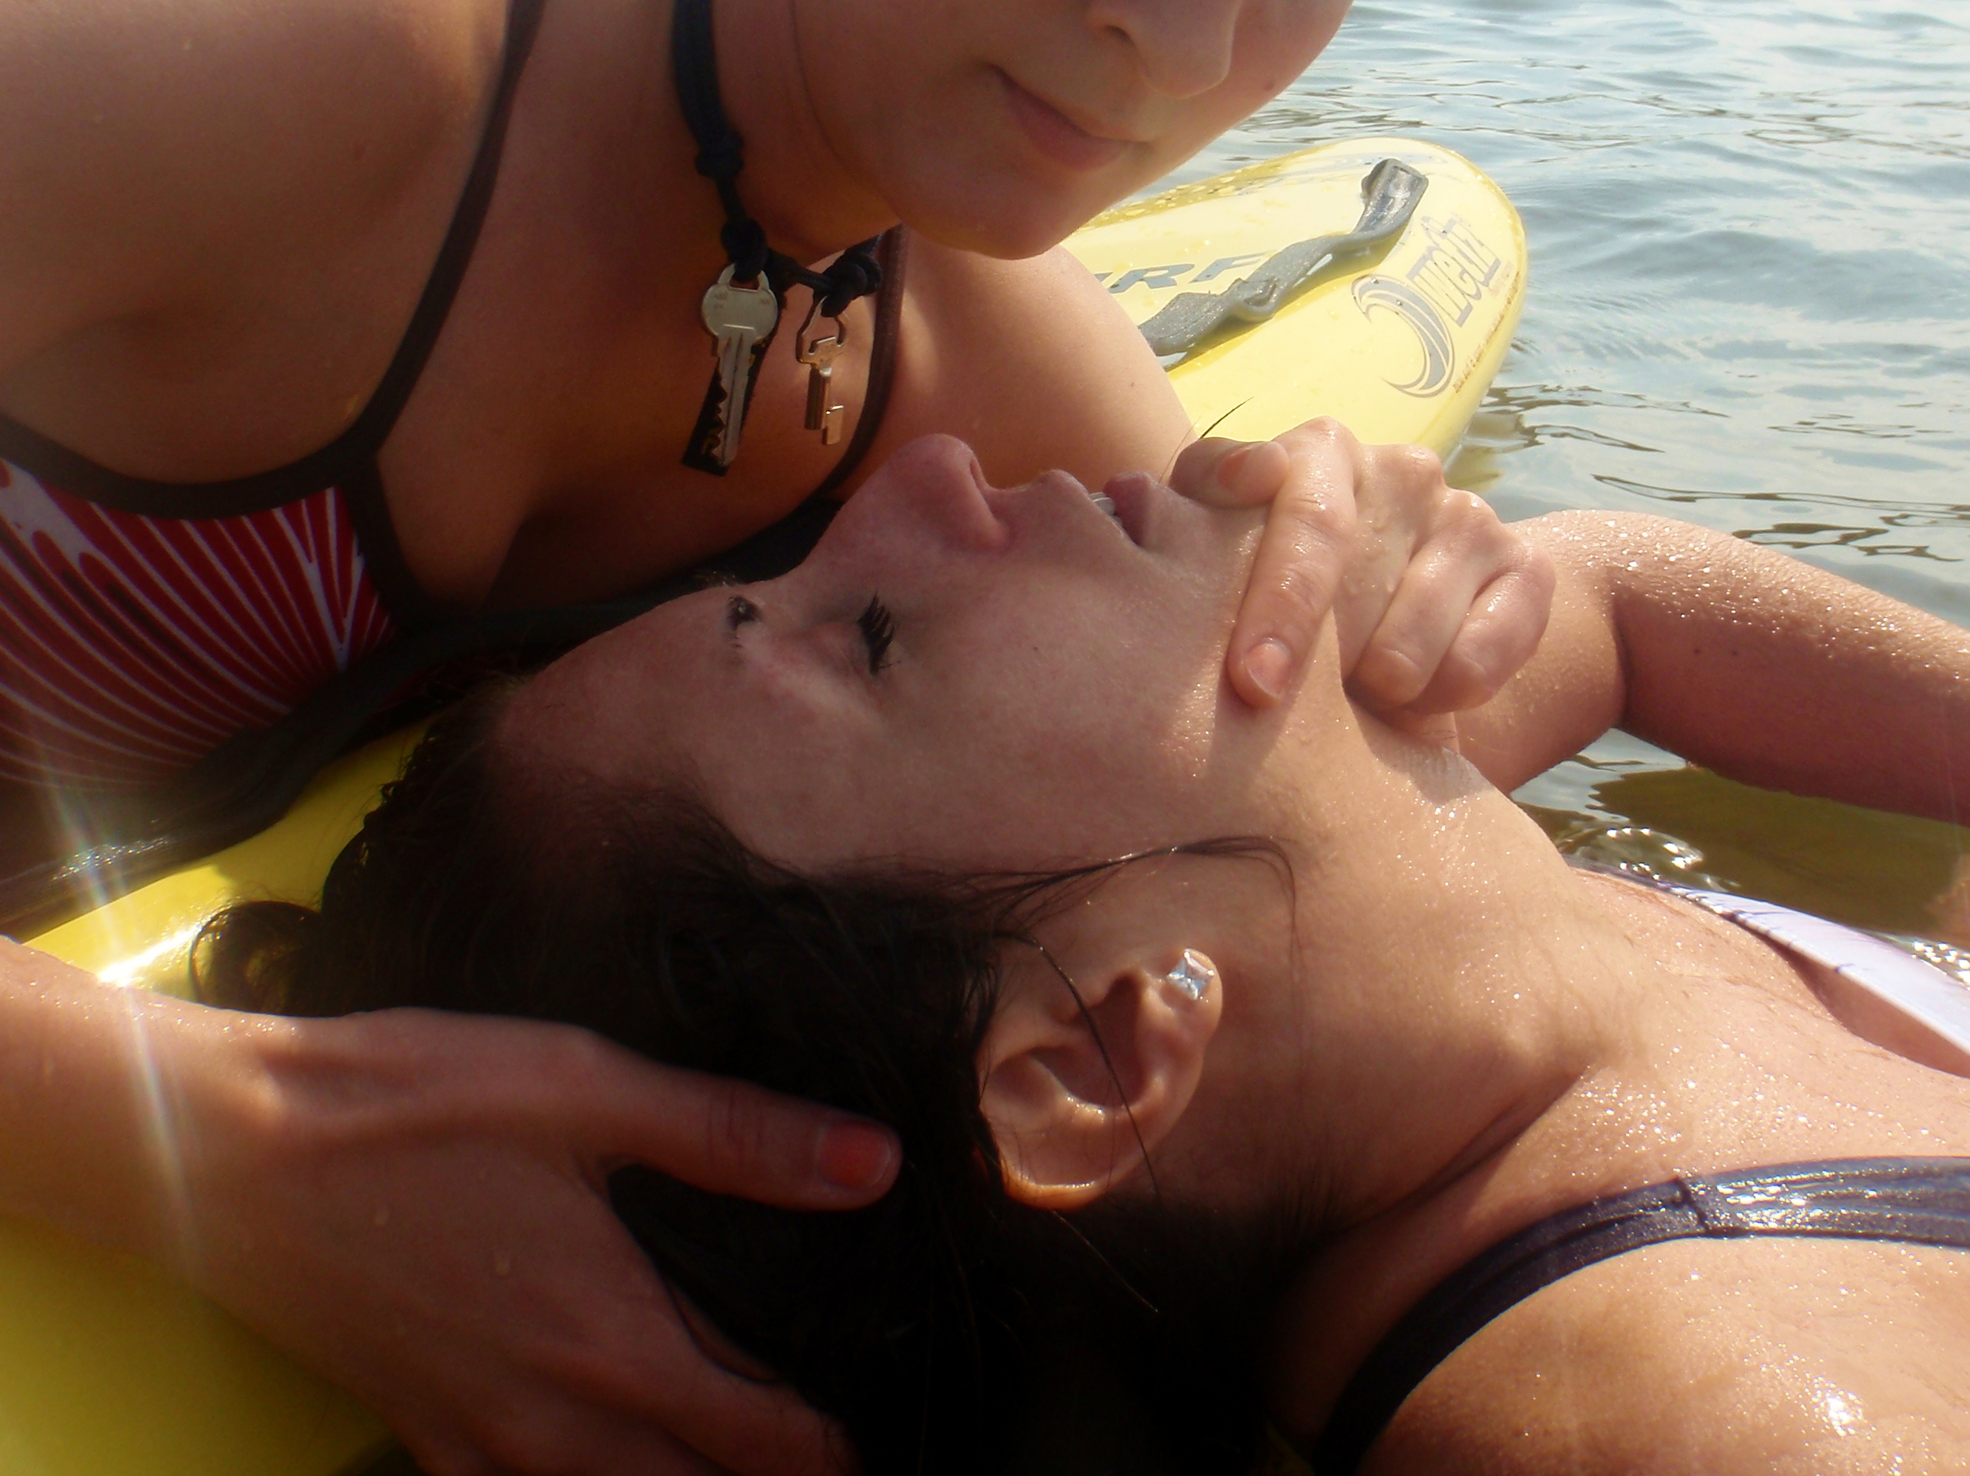

Slide 18
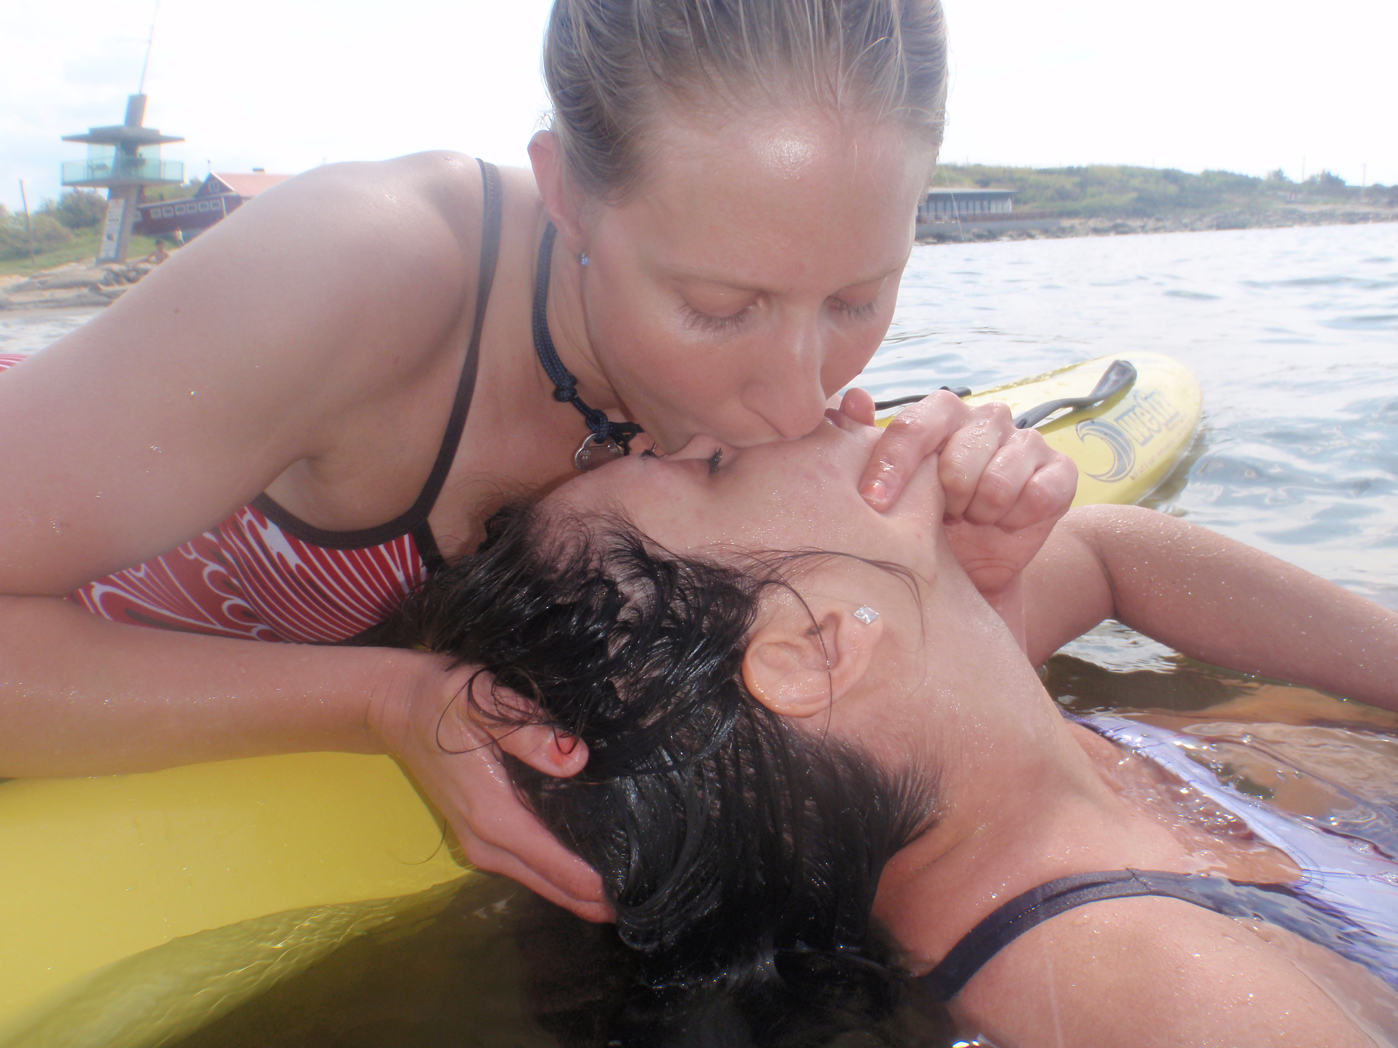

Slide 19
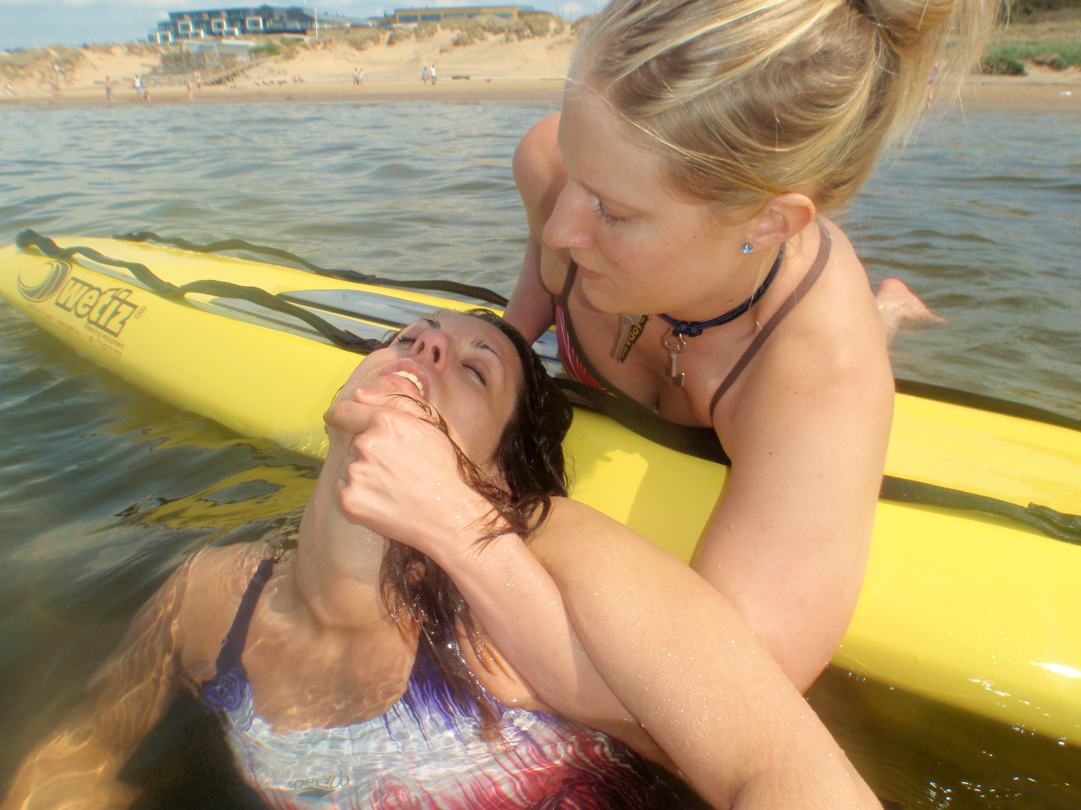
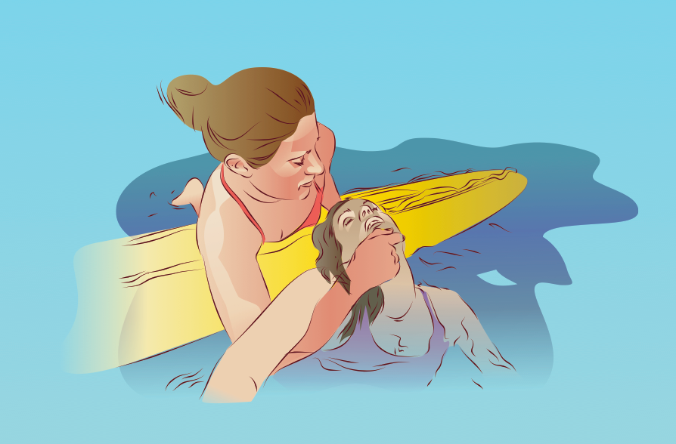
HLR2014 - Om Drunkning Tylösand 3-4 juni 2014

Slide 20
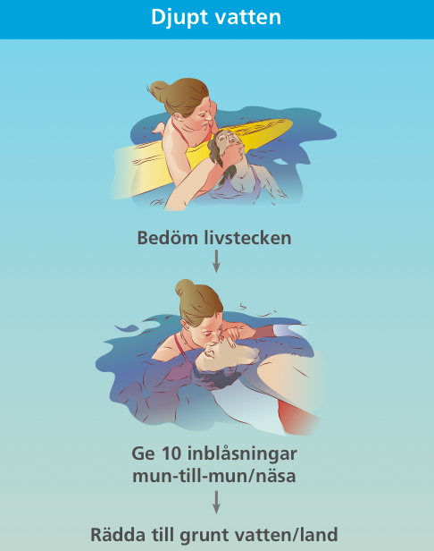

Slide 21
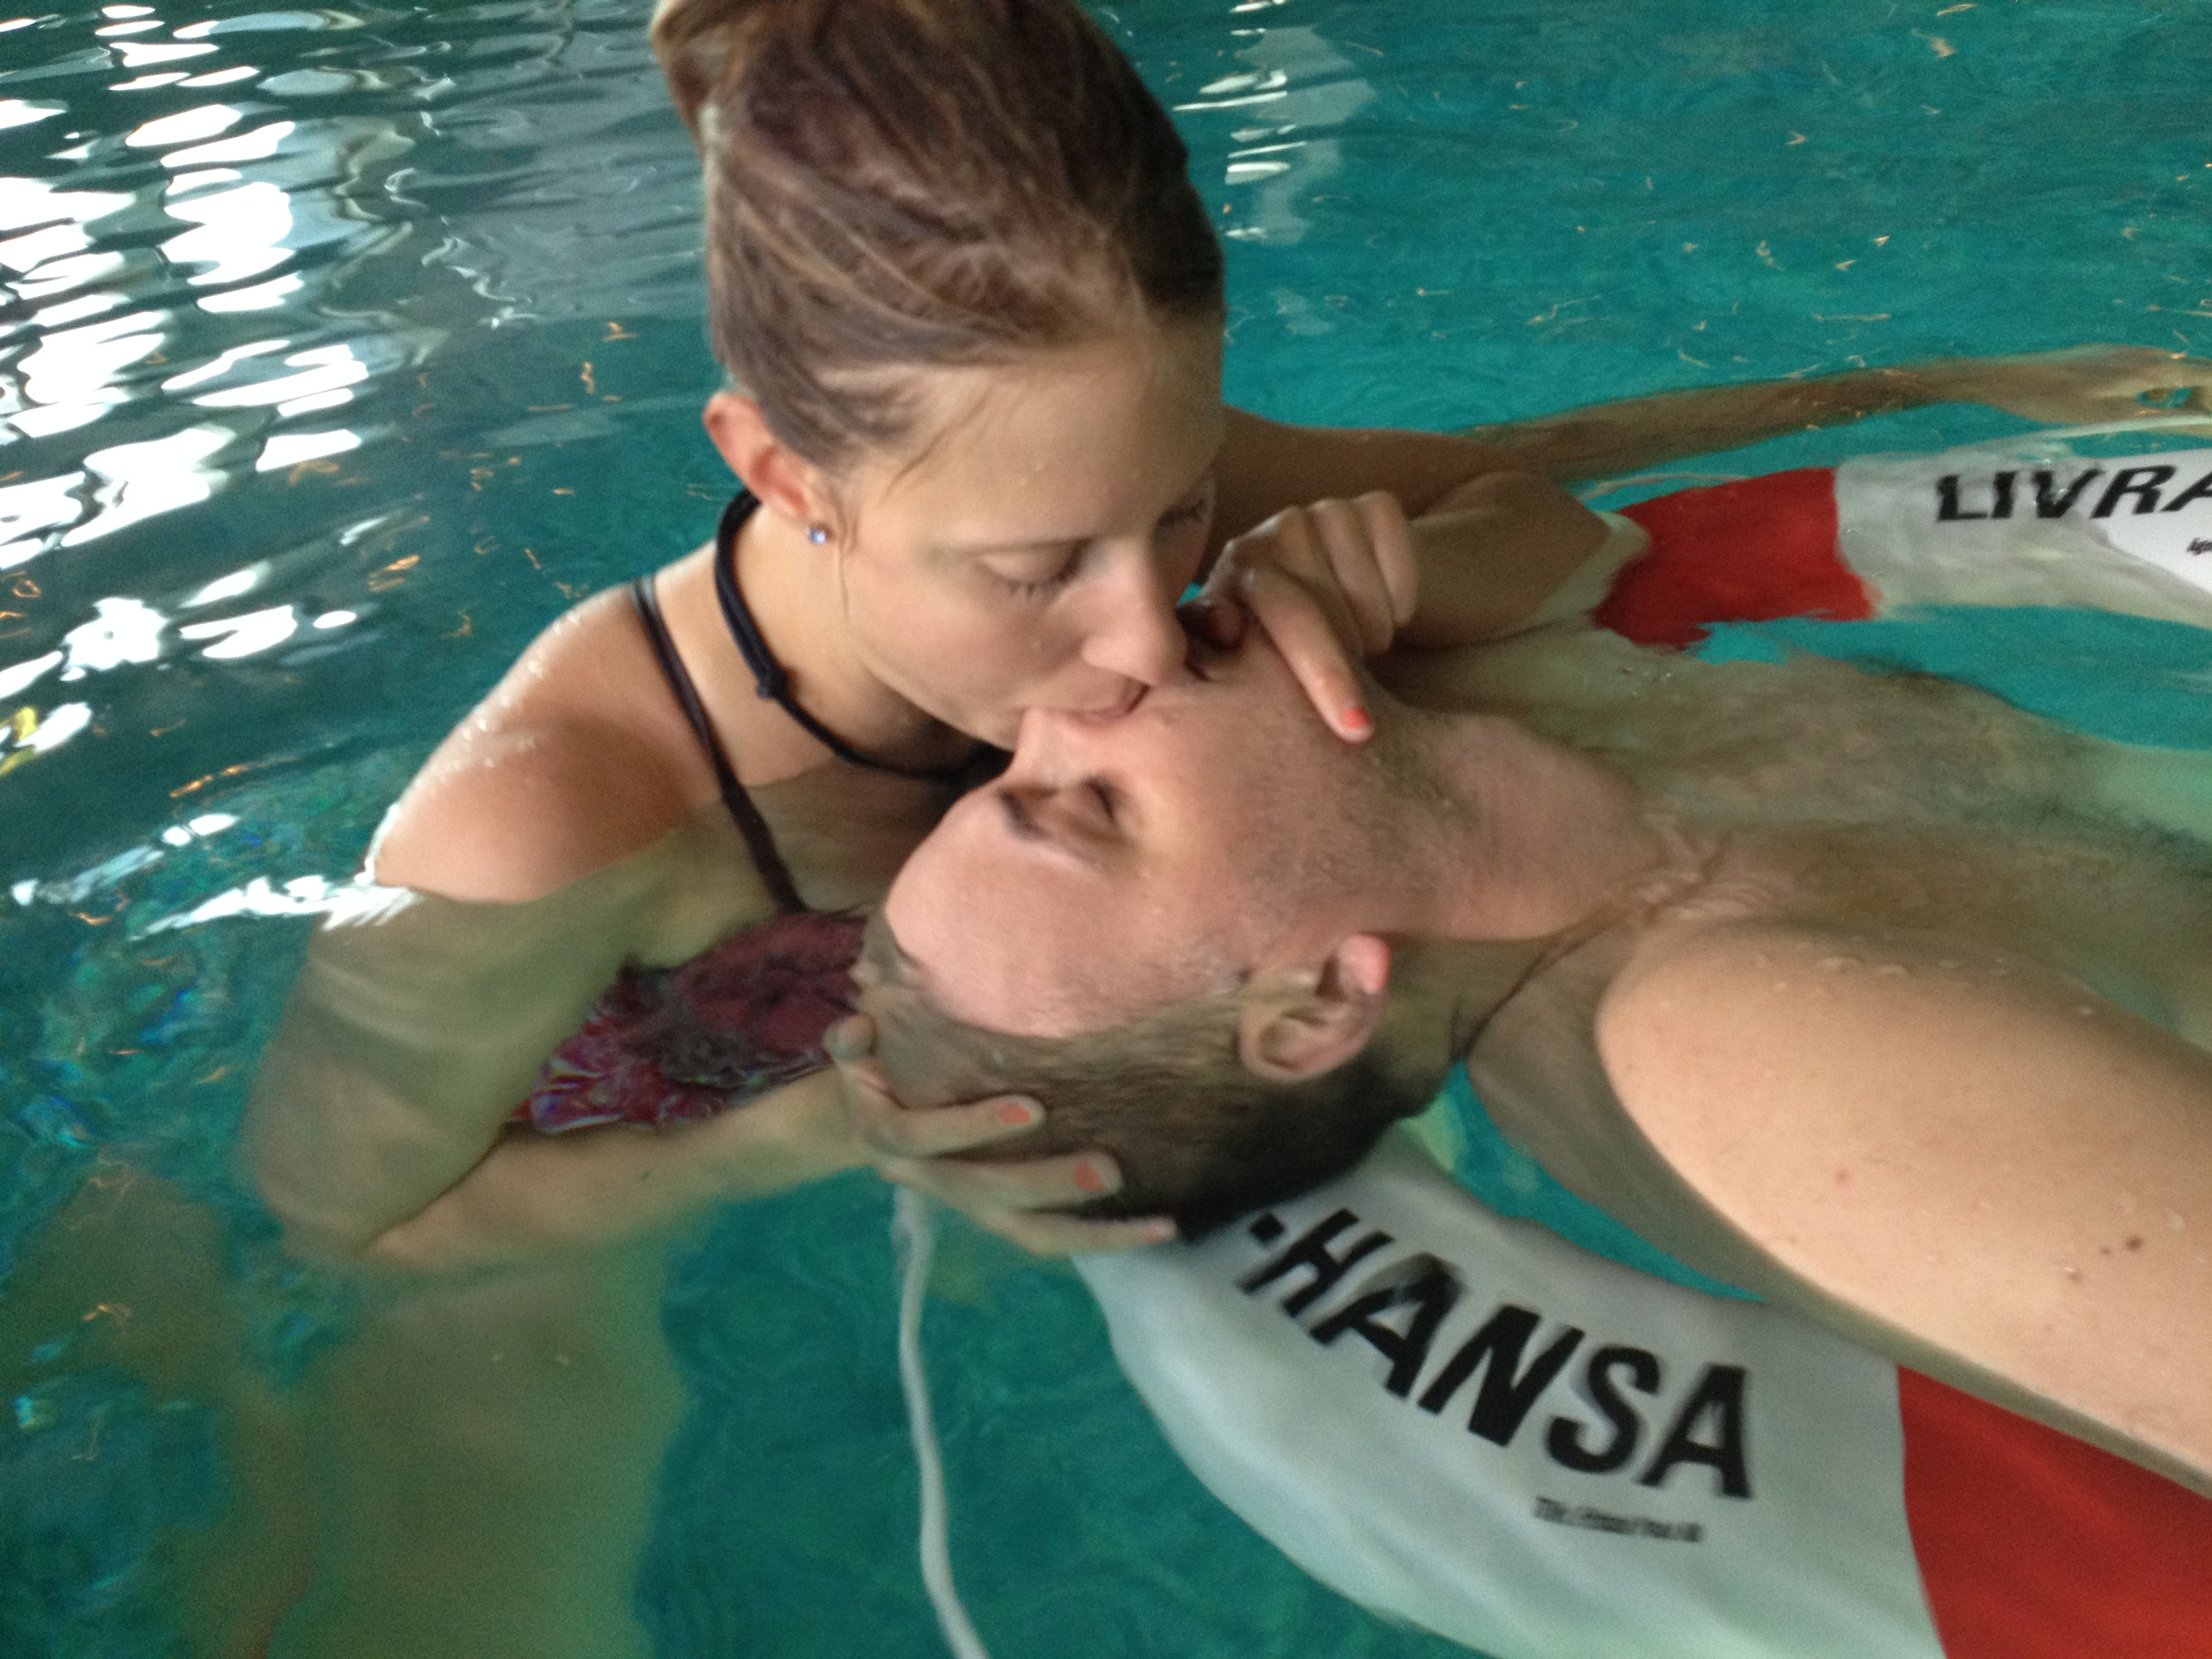
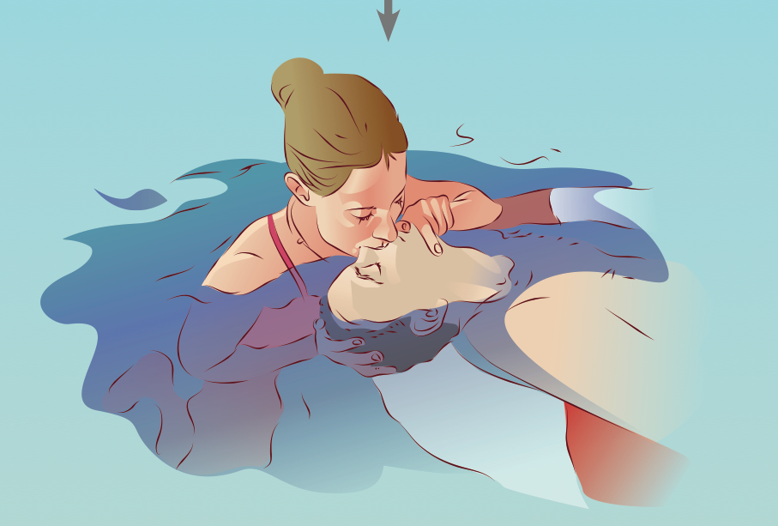
HLR2014 - Om Drunkning Tylösand 3-4 juni 2014

Slide 22
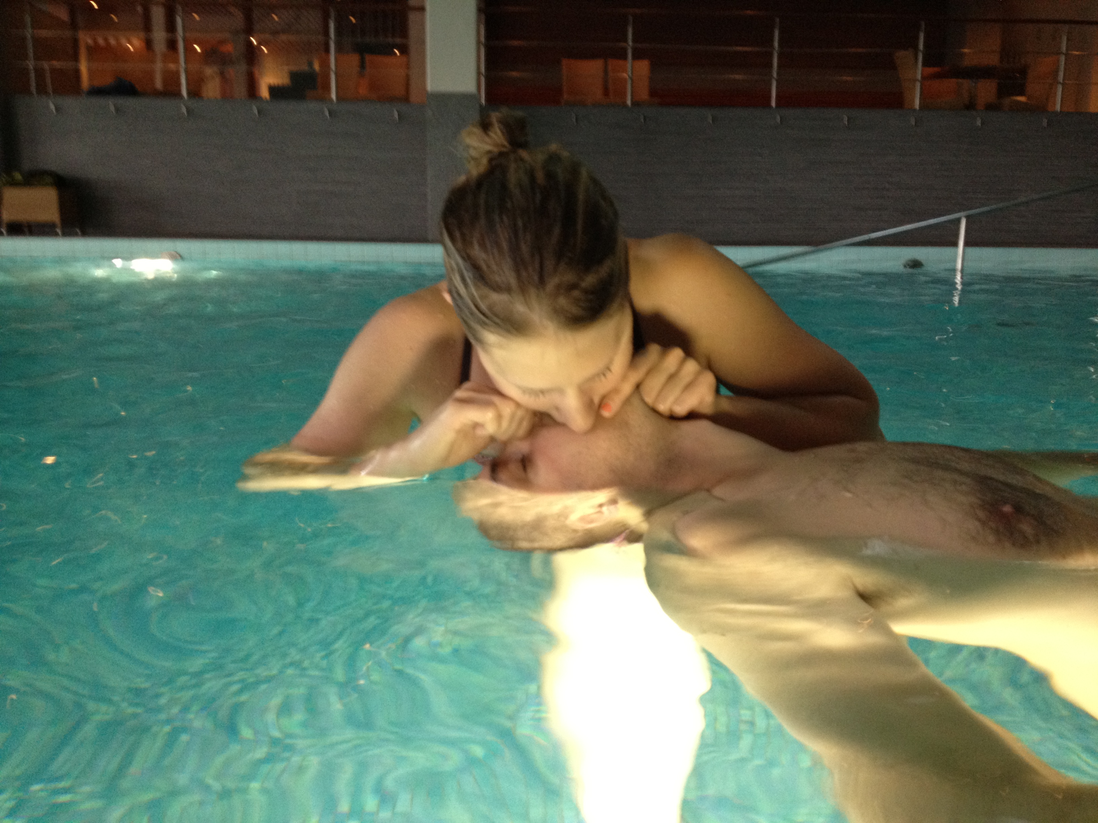
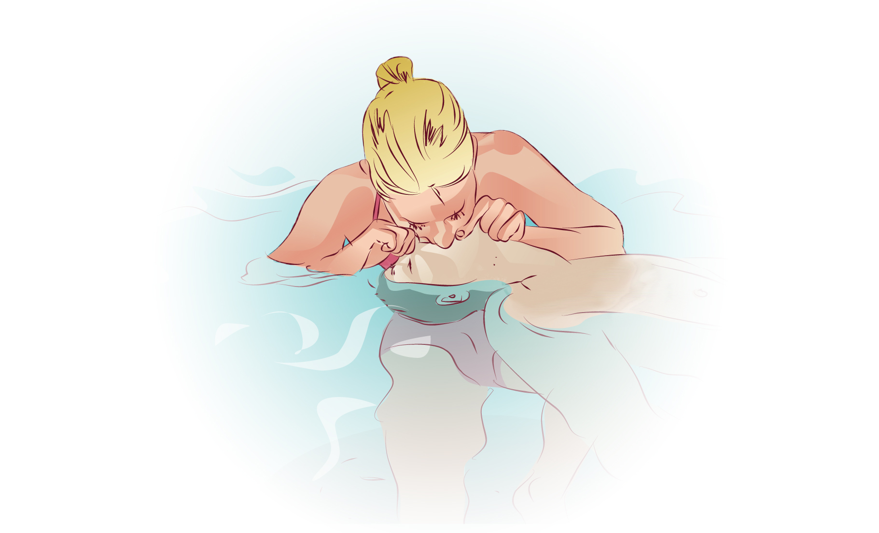
HLR2014 - Om Drunkning Tylösand 3-4 juni 2014

Slide 23
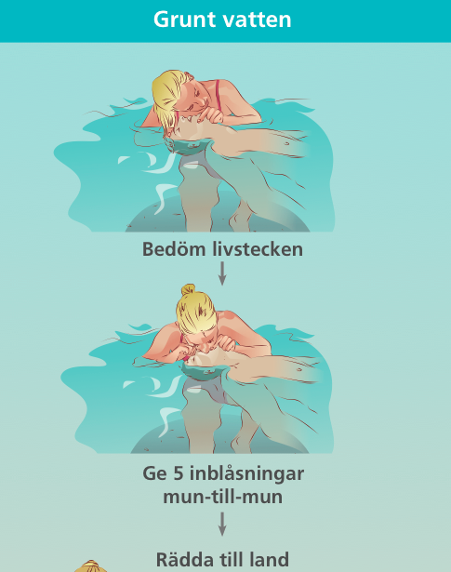


Slide 24
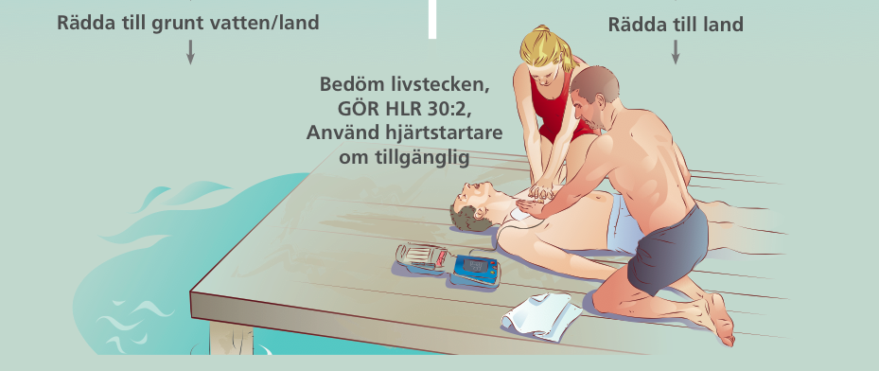

Slide 25
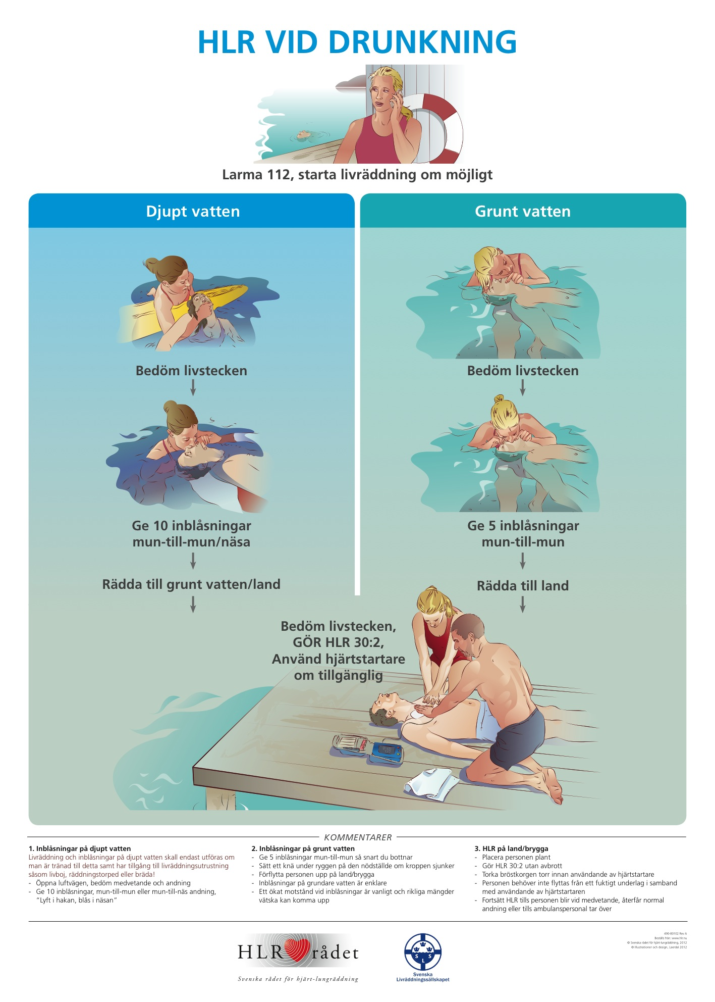

Slide 26
New BLS - drowning algorithm
- Swedish CPR council 2013
Andreas Claesson
Paramedic, RN/PhD
HLR2014 - Om Drunkning Tylösand 3-4 juni 2014

