Slide 1
A new drowning research agenda (for high-income countries)
Joost J.L.M. Bierens MD PhD MCDM
Anesthesiologist
Maatschappij tot Redding van Drenkelingen
(Society to Rescue People from Drowning, established 1767)

Slide 2
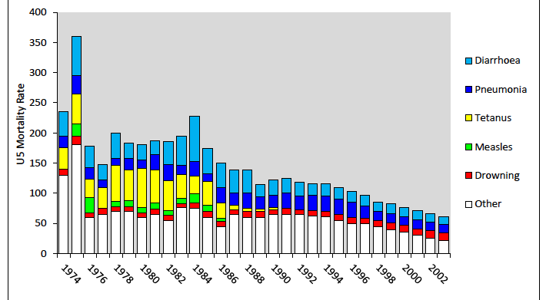
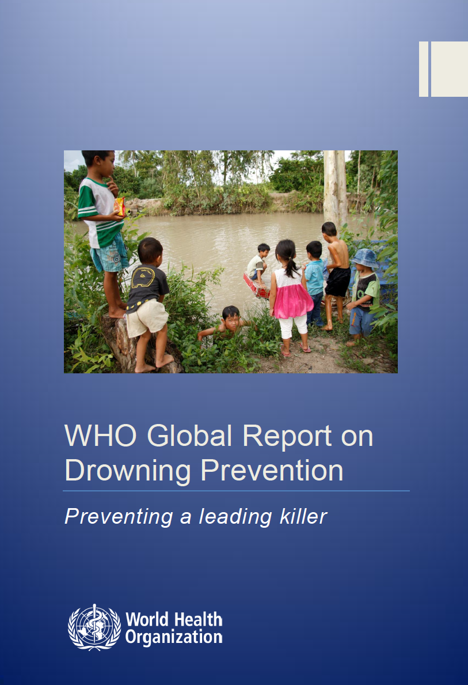

Slide 3
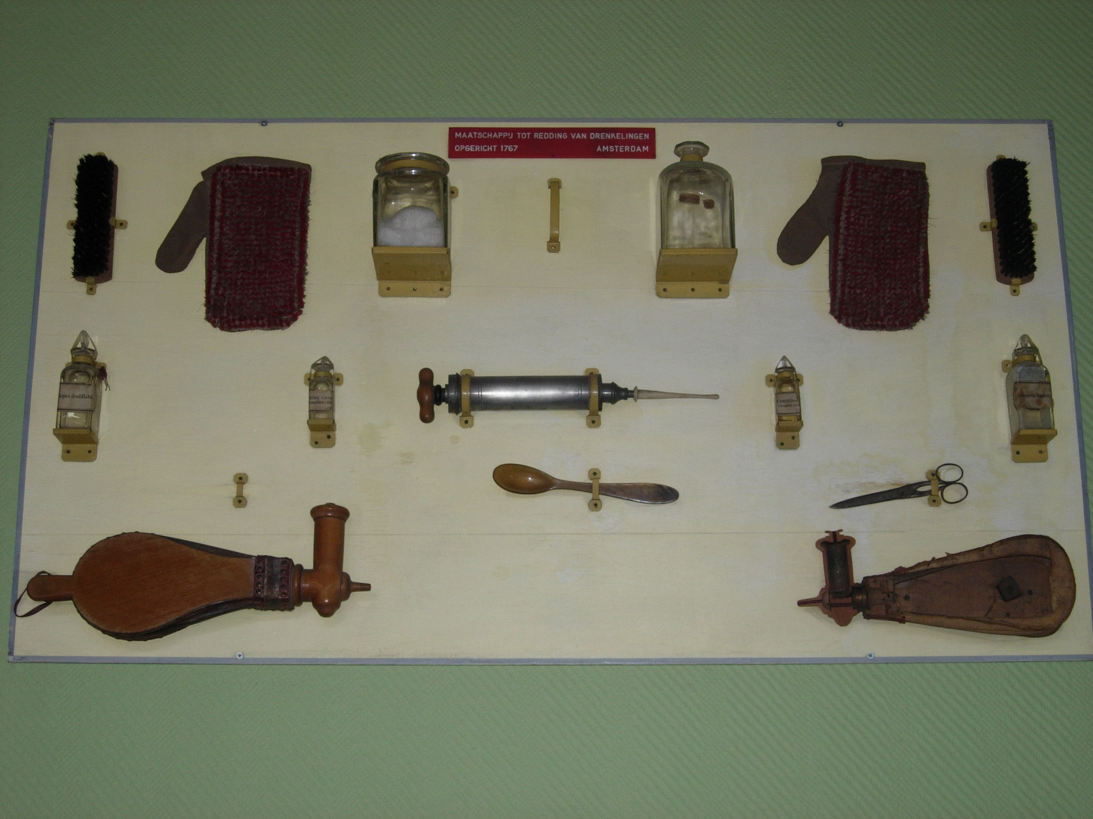
Drowning in the 18th century

Slide 4
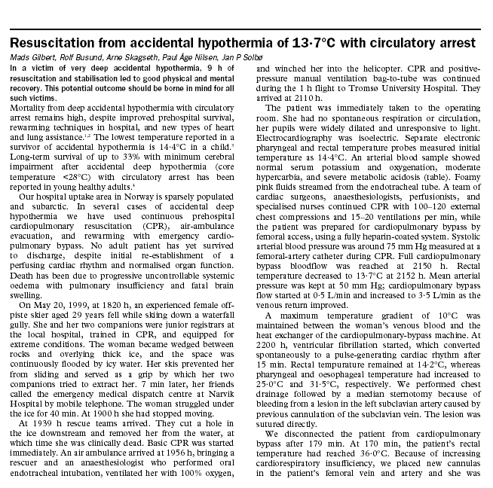
Current status drowning research
Most of all case reports

Slide 5
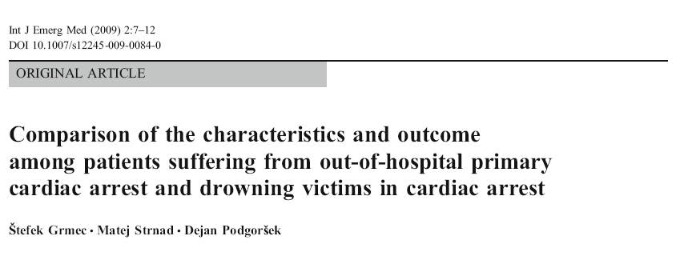
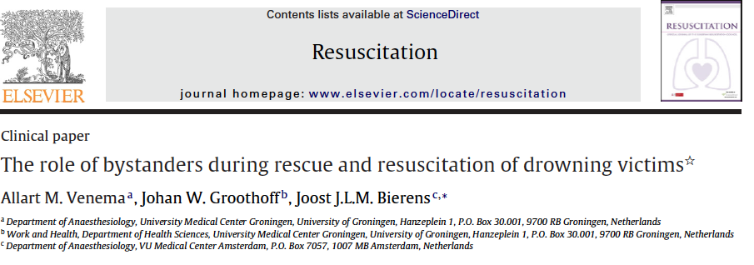
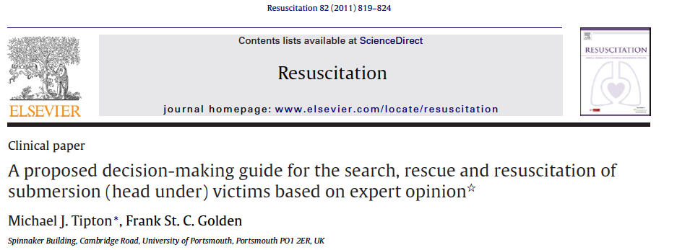
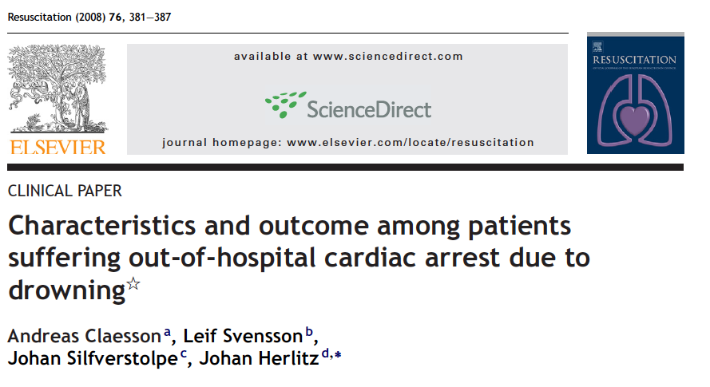
Current status drowning research
Some cohort studies – retrospectively pooled data

Slide 6
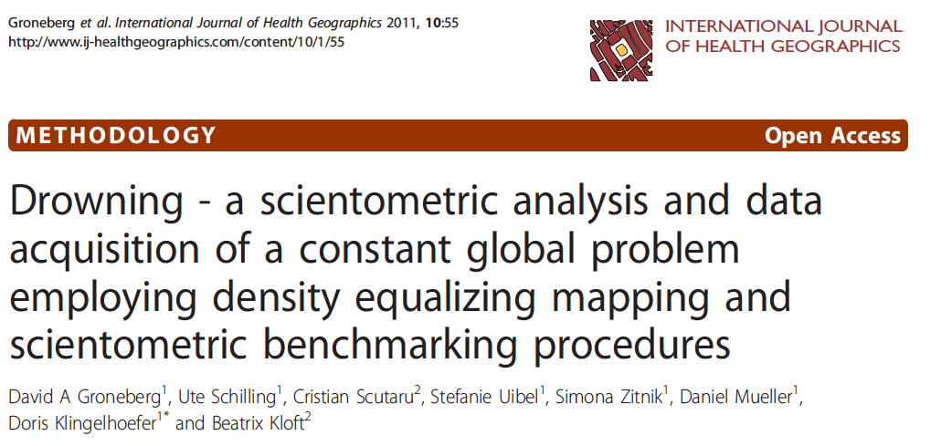
Number of drowning publications 1900-2005

Slide 7
WHY RESEARCH
to describe
to understand
to replace impressions by data
to improve quality of performance
to obtain political support
to obtain financial support
to demonstrate professionalism
to give the best care to the victim

Slide 8
Important drowning research domains
Epidemiology
Prevention
Rescue
Pathophysiology
Resuscitation
Education
Most of all:
national, all-inclusive and multidisciplinary
registration of fatal and non-fatal drowning
should be initiated

Slide 9
Two basic principles of data registration
Clearly define the objective of the registration
Operational data: what is happening
Strategic data: indicators for political and financial issues
Research data: to improve the current situation
Only include items in a registration that are
Relevant for the objective of the registration (need to know)
Available
Reliable

Slide 10
Drowning research
Research is a strong instrument to change a situation.
Most important, and difficult: a relevant research question. The research question defines which data are relevant to collect.
Make use of:
Definition of drowning (WCOD 2002)
International Classification of Diseases (ICD-codes)
Utstein score for drowning research
Acknowledged clasification systems (over 40)

Slide 11
Example: Study Royal Dutch Lifeboat Institute
Pre-ambule: each year 1200 crew members are (re)trained in first aid, BLS and additional skills to treat submersion, immersion hypothermia, and spine injuries (EHBOplus).
Research question: how often do crew members apply these skills and under which circumstances ?
Results: During 8 years: 17.001 interventions at sea; medical care provided to 131 victims; of which 49 submersion, immersion, hypothermia often in combination with other injuries; 13 persons were resuscitated. 60% in bad weather conditions
Conclusion: after initial first aid and BLS courses, crew should be trained with complex scenarios under realistic circumstances

Slide 12
Important drowning research domains
Epidemiology
Prevention
Rescue
Pathophysiology
Resuscitation
Education

Slide 13
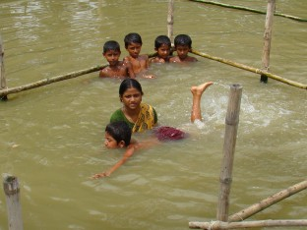
Prevention
in low-income countries, 4 drowning intervention measures have been proven effective
close supervision
survival swimming lessons
barriers close to children
barriers around water
in high-income countries, the incidence of drowning is too low to measure the effects of interventions

Slide 14
Water competence model
Water competence
Knowledge of dangers
Swimming competence
Behaviour
Aquatic environment

Slide 15
Drowning prevention studies
measure effects of interventions on water competencies (hypothesis: this affects drowning)
Open water swimming lessons
Campaigns that point at dangers of alcohol use
Information to the public on dangerous situations, with ICT technologies
measure effects of 16 open water drowning prevention guidelines
Support prevention studies in low income countries

Slide 16
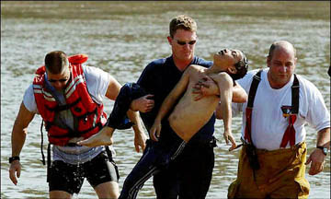
Rescue
Gradually, the requirements for effective rescue are becoming clear
Recognition and detection of a potential drowning victim
Reduction hypoxic period
Under water
During transport to land
Until start CPR
Safety of the rescuer
Death
Injuries
Psychological
Added value of new rescue equipment

Slide 17
Drowning pathophysiology
In its most simple form, drowning is a respiratory problem.
hypoxia causes that a healthy heart is braking down
gradually the heart stops and hypoxic damage to the brain occurs
drowning cardiac arrest is unlike cardiac cardiac arrest resuscitation – notably VF is rare (0-8%)
however: drowning has many faces

Slide 18
Research to better understand drowning pathophysiology
Mechanism and sequence of events during hypoxic arrest
Heart
Brain
Mechanisms and incidence of
Laryngospasm
Aspiration
Diving reflex
Autonomic conflict
Cold shock
Immersion hypothermia

Slide 19
Research to better understand drowning resuscitation
Animal studies
Number of initial ventilation before cardiac compressions (2 – 5 – 10?)
Ventilation - compression ratio
Compression-only CPR after hypoxic cardiac arrest
Effect compressions on hypoxic, hypothermic and acidotic heart

Slide 20
Research to better understand drowning resuscitation
Effect of techniques and devices on ventilation, oxygenation, circulation and neurological damage
Rescue
In-water ventilation
Cricoid pressure
Oxygen
Supraglottic airway
AED
LUCAS

Slide 21
Research to measure drowning morbidity and its relationship with quality of rescue and CPR
Cardiac consequences
Rhythm
Cardiac performance
Pulmonary consequences
Pneumonia
ARDS
Neurological consequences
Neurological outcome
Neurocognitive tests

Slide 22
Resuscitation training research
How to improve quality of CPR
Can layperson distinguish between drowning cardiac arrest resuscitation guidelines and cardiac cardiac arrest guidelines
One-person CPR vs team CPR
Effect of training under real circumstances on quality of CPR, learning curve, performance, retention and retrieval

Slide 23
Many directions to go in drowning research

Slide 24
Research is a trip to the stars

Slide 25
To be prepared for research
Use acknowledged definitions, codes, templates and categories
Collaboration with research institutes
International collaboration if needed
Open communication with other researchers
Focus, prioritisation
Management of time and private life

Slide 26
The new drowning research agenda: synchronised swimming

Slide 27
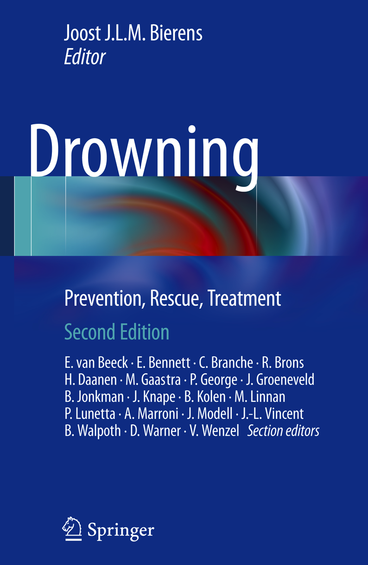
Questions
jbierens@euronet.nl

Slide 28
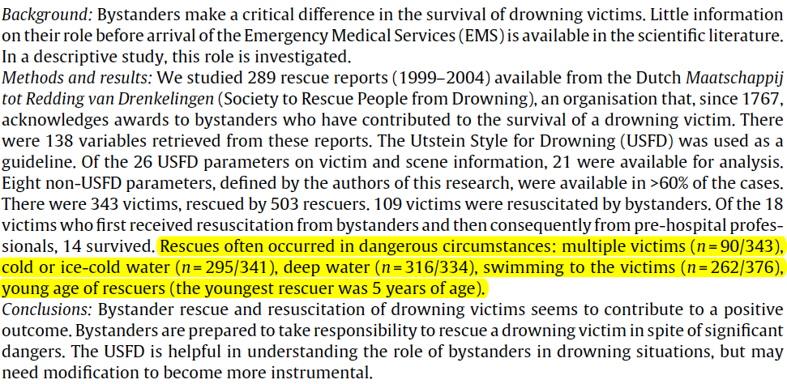
Most rescuers are by bystanders

