Slide 1
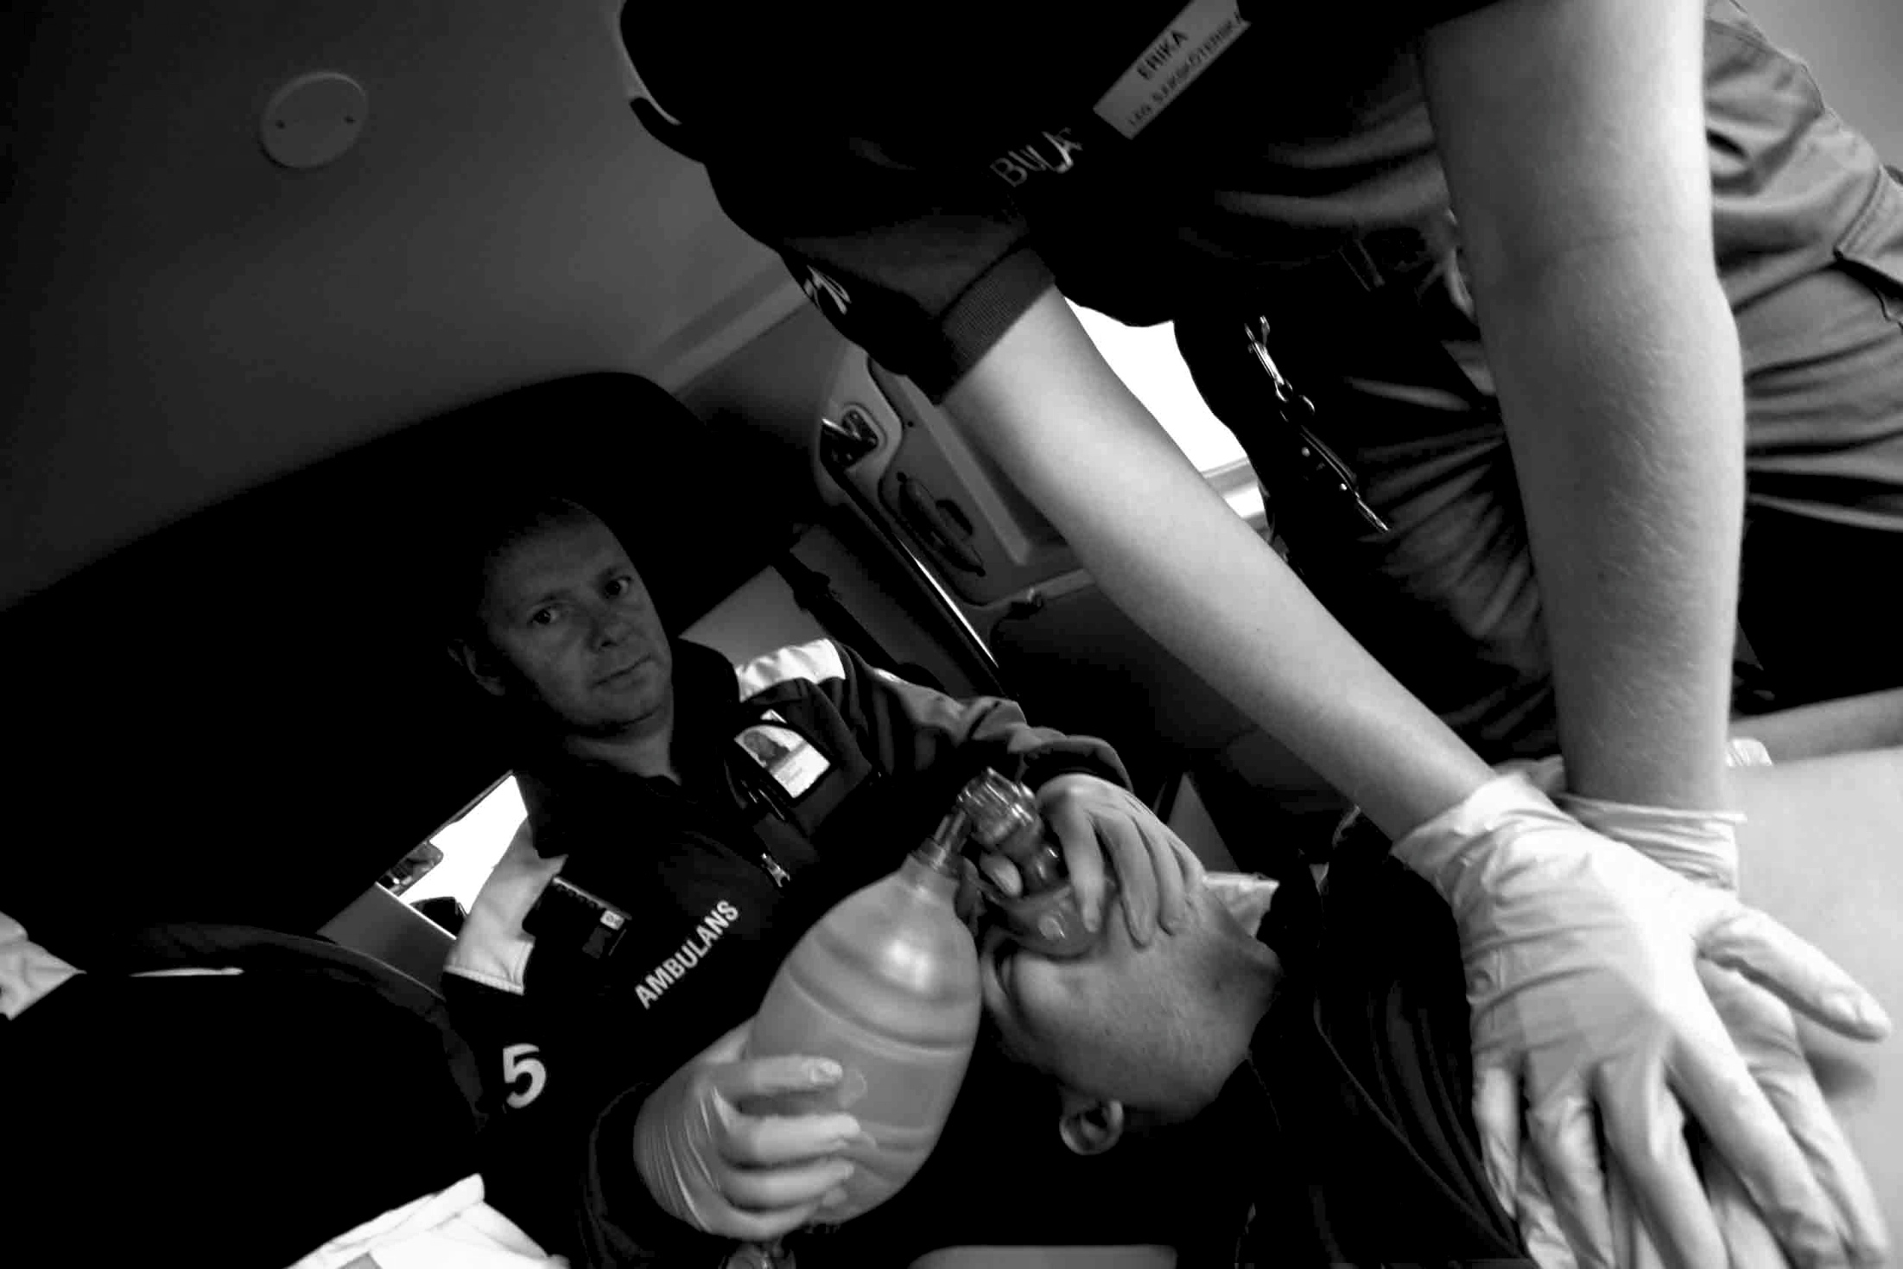
Cardiac arrest due to drowning
Cardiac arrest due to drowning
Sweden 1992-2012
- Sweden over 20 years
Andreas Claesson
Paramedic, RN/PhD
HLR2014 - Om Drunkning Tylösand 3-4 juni 2014

Slide 2
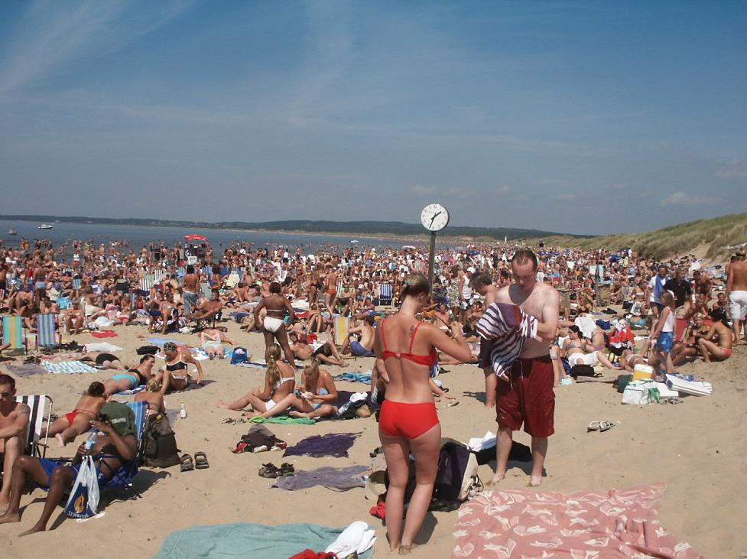

Slide 3
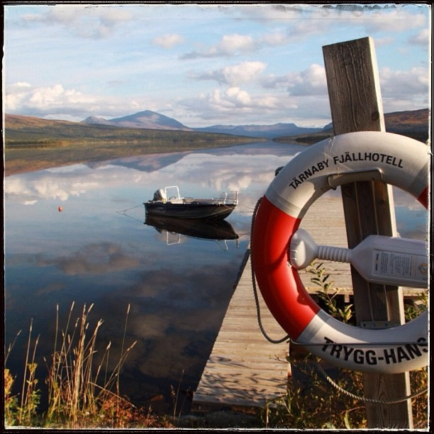

Slide 4
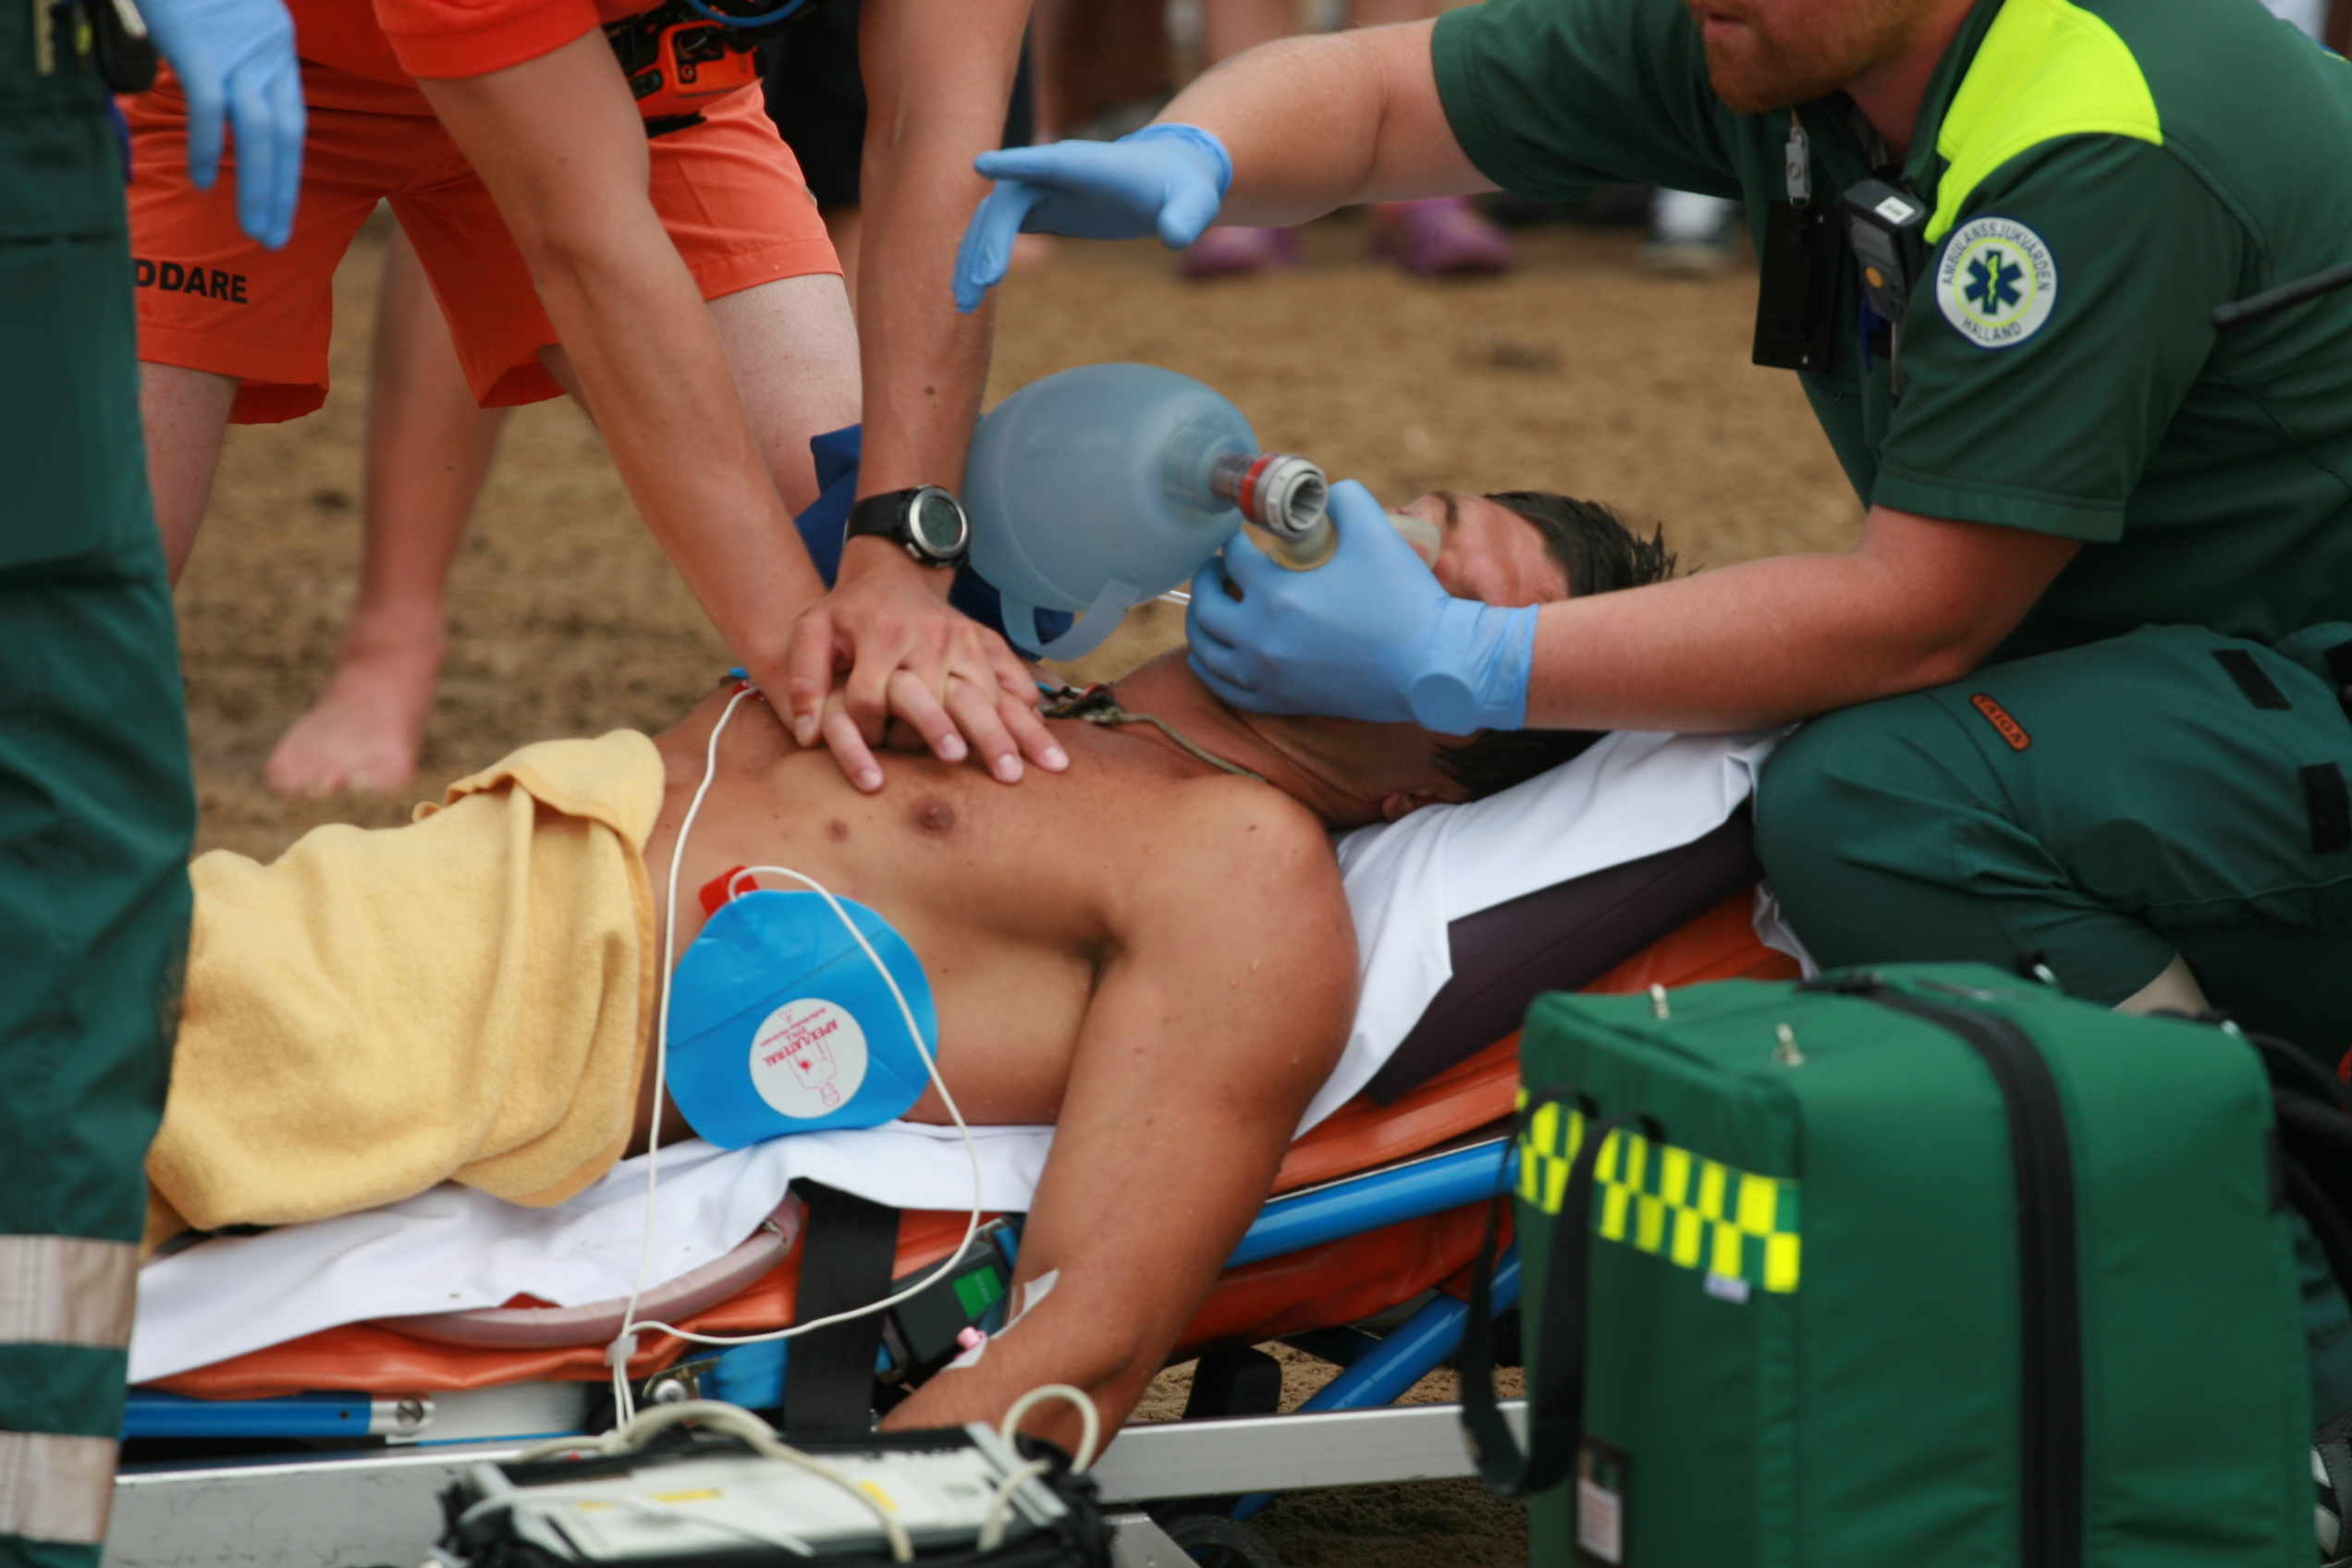
Introduktion
Patofysiologi

Slide 5
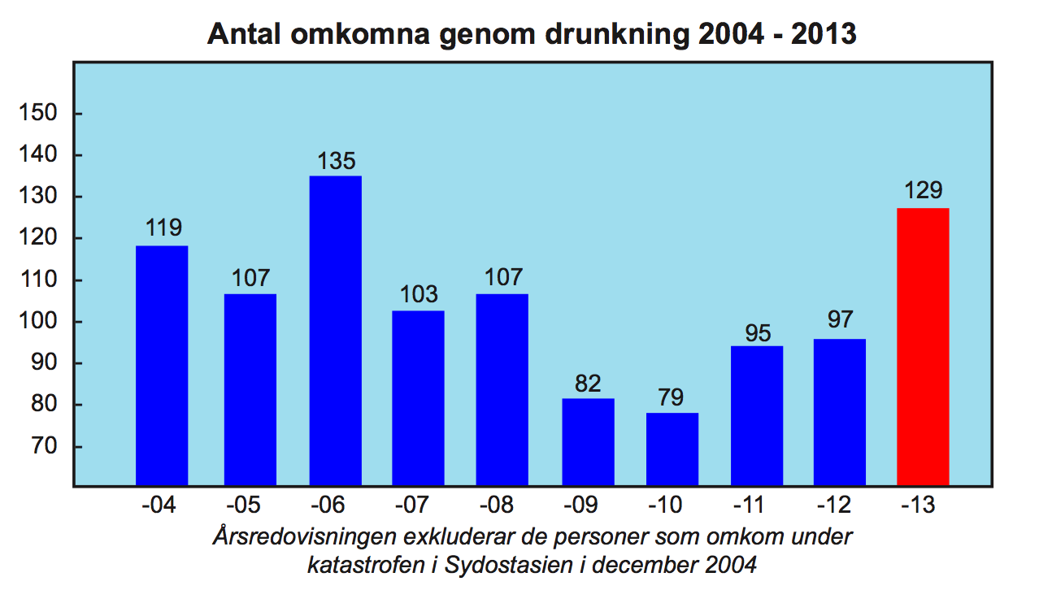
Incidence of drowning accidents
- Swedish lifesaving society (SLS), drowning deaths 2004-2013
HLR2014 - Om Drunkning Tylösand 3-4 juni 2014

Slide 6
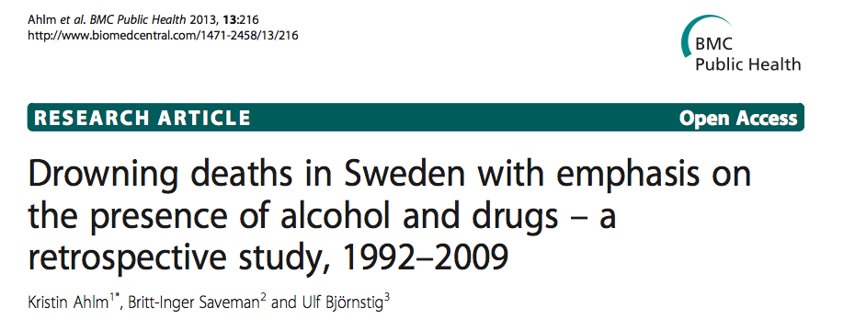
HLR2014 - Om Drunkning Tylösand 3-4 juni 2014

Slide 7
Incidence of drowning deaths
- Sweden 1992-2009
Accidents: n=2,585 (50%)
Suicide: n=1,610 (31%)
Unclear cases: n=909 (18%)
Homocide: n=21
___________________________________
Mean: 285 /year
Ahlm et al. BMC Public Health 2013, 13:216
HLR2014 - Om Drunkning Tylösand 3-4 juni 2014

Slide 8
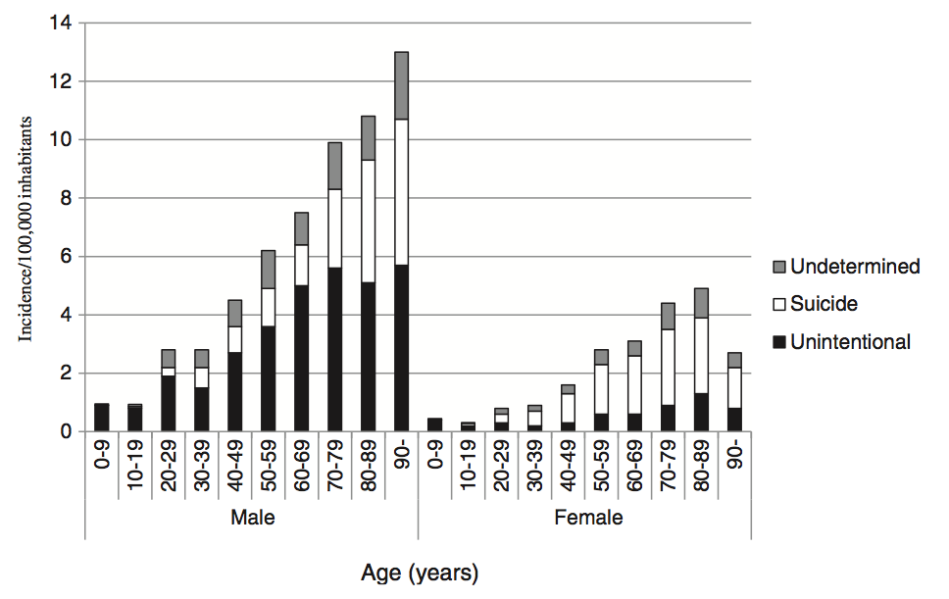
Incidence of drowning deaths
- Sweden 1992-2009, Incidence/100,000 inhabitants
Ahlm et al. BMC Public Health 2013, 13:216
HLR2014 - Om Drunkning Tylösand 3-4 juni 2014

Slide 9
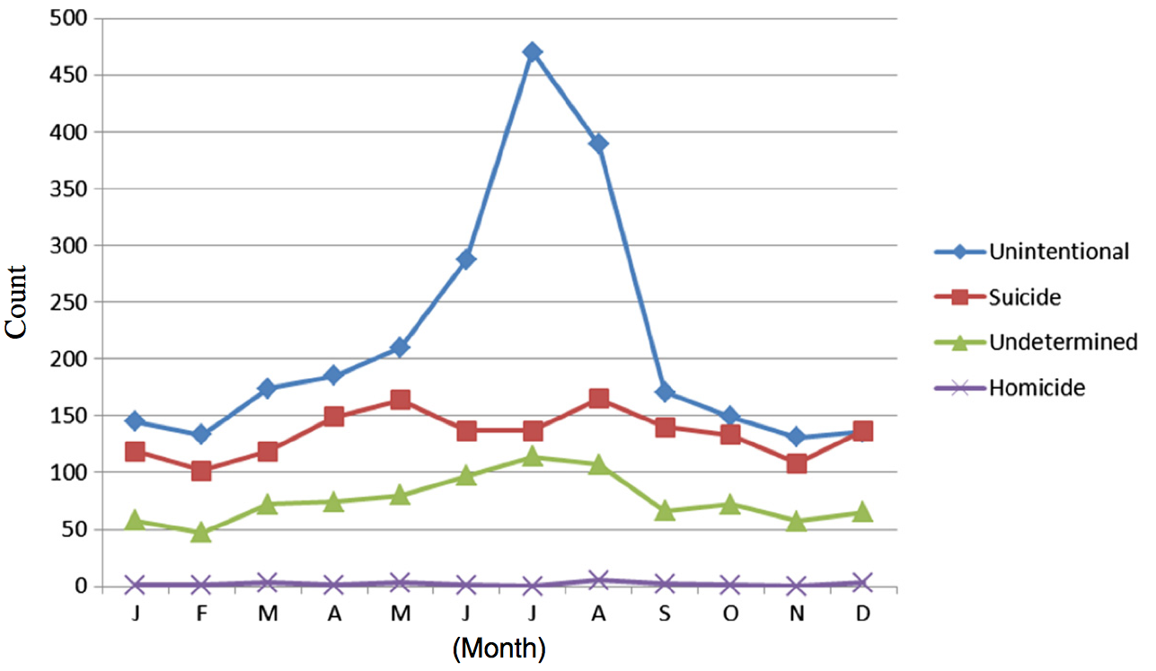
Incidence of drowning deaths
- In relation to months and manner of death
Ahlm et al. BMC Public Health 2013, 13:216
HLR2014 - Om Drunkning Tylösand 3-4 juni 2014

Slide 10
Characteristics of drowning deaths
Incidence decreased on average by about 2% each year (p<0.001).
The incidence increased 3% for each year of age.
Children/adolescents (≤18 years) constituted 5% of all drowning deaths.
In total, 38% of tested drowned persons had alcohol in their blood and the mean concentration was 1.8 g/l.
One or several psychoactive drugs were present in the blood in 40% of all tested persons
The most common drug was benzodiazepines (21%)
Ahlm et al. BMC Public Health 2013, 13:216
HLR2014 - Om Drunkning Tylösand 3-4 juni 2014

Slide 11
Non-fatal drownings
Article | Estimated Incidence
Suominen, P. K. & Vahatalo, R. (2012). Neurologic long term outcome after drowning in children. Scandinavian Journal of Trauma, Resuscitation and Emergency Medicine, 20, 55. | It has been estimated that the number of non-fatal drownings are two to four times higher than the numbers of fatal drownings.
Layon, J. A. & Modell, J. H. (2009). Drowning. Anesthesiology, 110, 1390-1401. | 1 death per 13 survivors of a drowning episode in the United States
Onyekwelu, E. (2009). Drowning and near-drowning. The Internet Journal of Health, 8(2). | The estimated range [of near drowning] is thought to be at least 20-50 times the rate of drowning.
Brenner, R. A. (2003). Prevention of drowning in infants, children and adolescents. Pediatrics, 112, 440-445. | It is estimated that for each drowning death, there are 1 to 4 nonfatal submersions serious enough to result in hospitalization
Moon, R. E. & Long, R. J. (2002). Drowning and near-drowning. Emergency Medicine, 14, 377-386. | It is estimated that for every child who drowns, four are hospitalized and 16 receive emergency department care for near-drowning
Weinstein, M.D. & Krieger, B. P. (1996). Near-drowning: Epidemiology, pathophysiology and initial treatment. Journal of Emergency Medicine, 14, 461-467. | Near-drowning has been estimated to be from two-to twenty-fold more common than reported drownings.
Orlowski, J. P. (1988). Drowning, near-drowning, and ice-water drowning. JAMA, 260(3), 390-391. | Hospitalization for near drowning occurs five times more frequently than for drownings, and near-drowning accidents are estimated to be 500 to 600 times more common than their fatal counterpart
HLR2014 - Om Drunkning Tylösand 3-4 juni 2014

Slide 12
Drowning incidence 2012
- Sweden ratio 1:4, EMS vs Non EMS treated cases, n= ca 880 cases
Fatal: n=176 (1)
Non-EMS treated:
n=143 (81%)
Survivors: n= ca 704
EMS-treated:
n=4+?
Non-EMS treated:
n=?
EMS-treated (2):
n=33 (19%)
1) Registry for causes of death 2012
2) Swedish Cardiac arrest registry, 2012
HLR2014 - Om Drunkning Tylösand 3-4 juni 2014

Slide 13
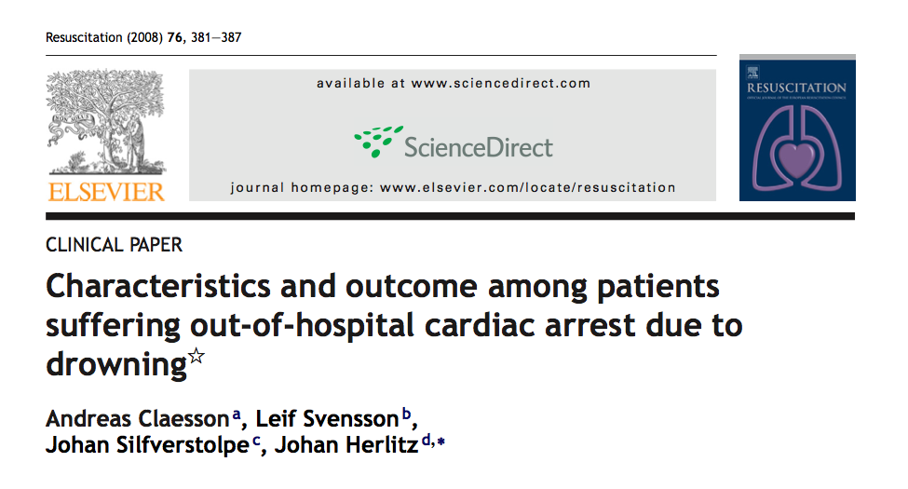
HLR2014 - Om Drunkning Tylösand 3-4 juni 2014

Slide 14
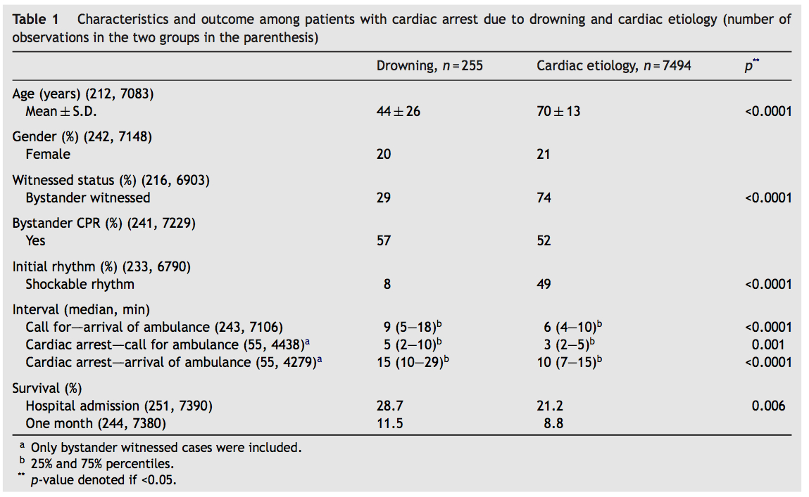
Delarbete 1 2 3 4 5
Syfte Metod Resultat Diskussion
HLR2014 - Om Drunkning Tylösand 3-4 juni 2014

Slide 15
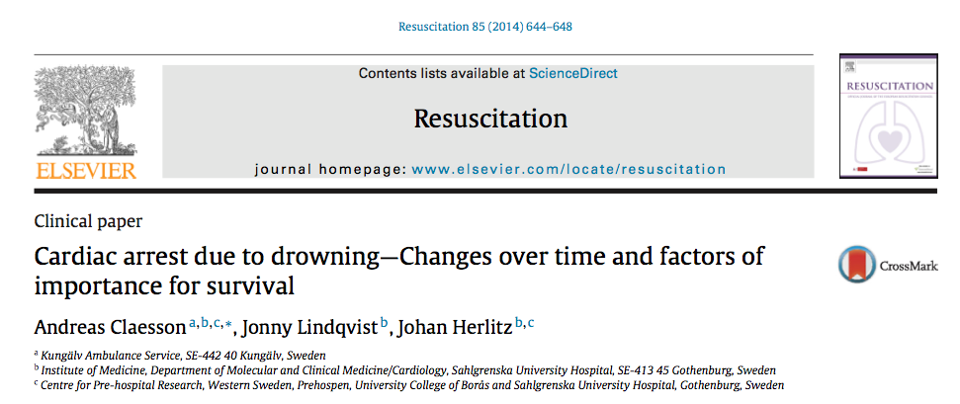
HLR2014 - Om Drunkning Tylösand 3-4 juni 2014

Slide 16
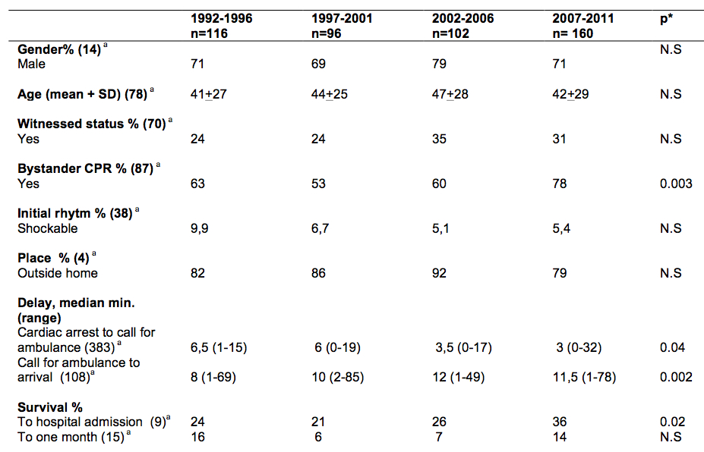
HLR2014 - Om Drunkning Tylösand 3-4 juni 2014

Slide 17
Conclusion
Approximately n = 880 individuals suffer from drowning in Sweden each year, of which n=176 (2012) die as a result of the event.
The EMS response time is increasing. Early arrival of EMS with initiation of advanced life support (ALS/ A-HLR) seems important for survival.
The proportion of bystander CPR is increasing as well as survival to hospital admission.
Survival in OHCA due to drowning when CPR is initiated is similar to that of OHCA of cardiac etiology - about 10%
HLR2014 - Om Drunkning Tylösand 3-4 juni 2014

Slide 18
Cardiac arrest due to drowning
Cardiac arrest due to drowning
Sweden 1992-2012
- Sweden over 20 years
Andreas Claesson
Paramedic, RN/PhD
HLR2014 - Om Drunkning Tylösand 3-4 juni 2014

