Slide 1
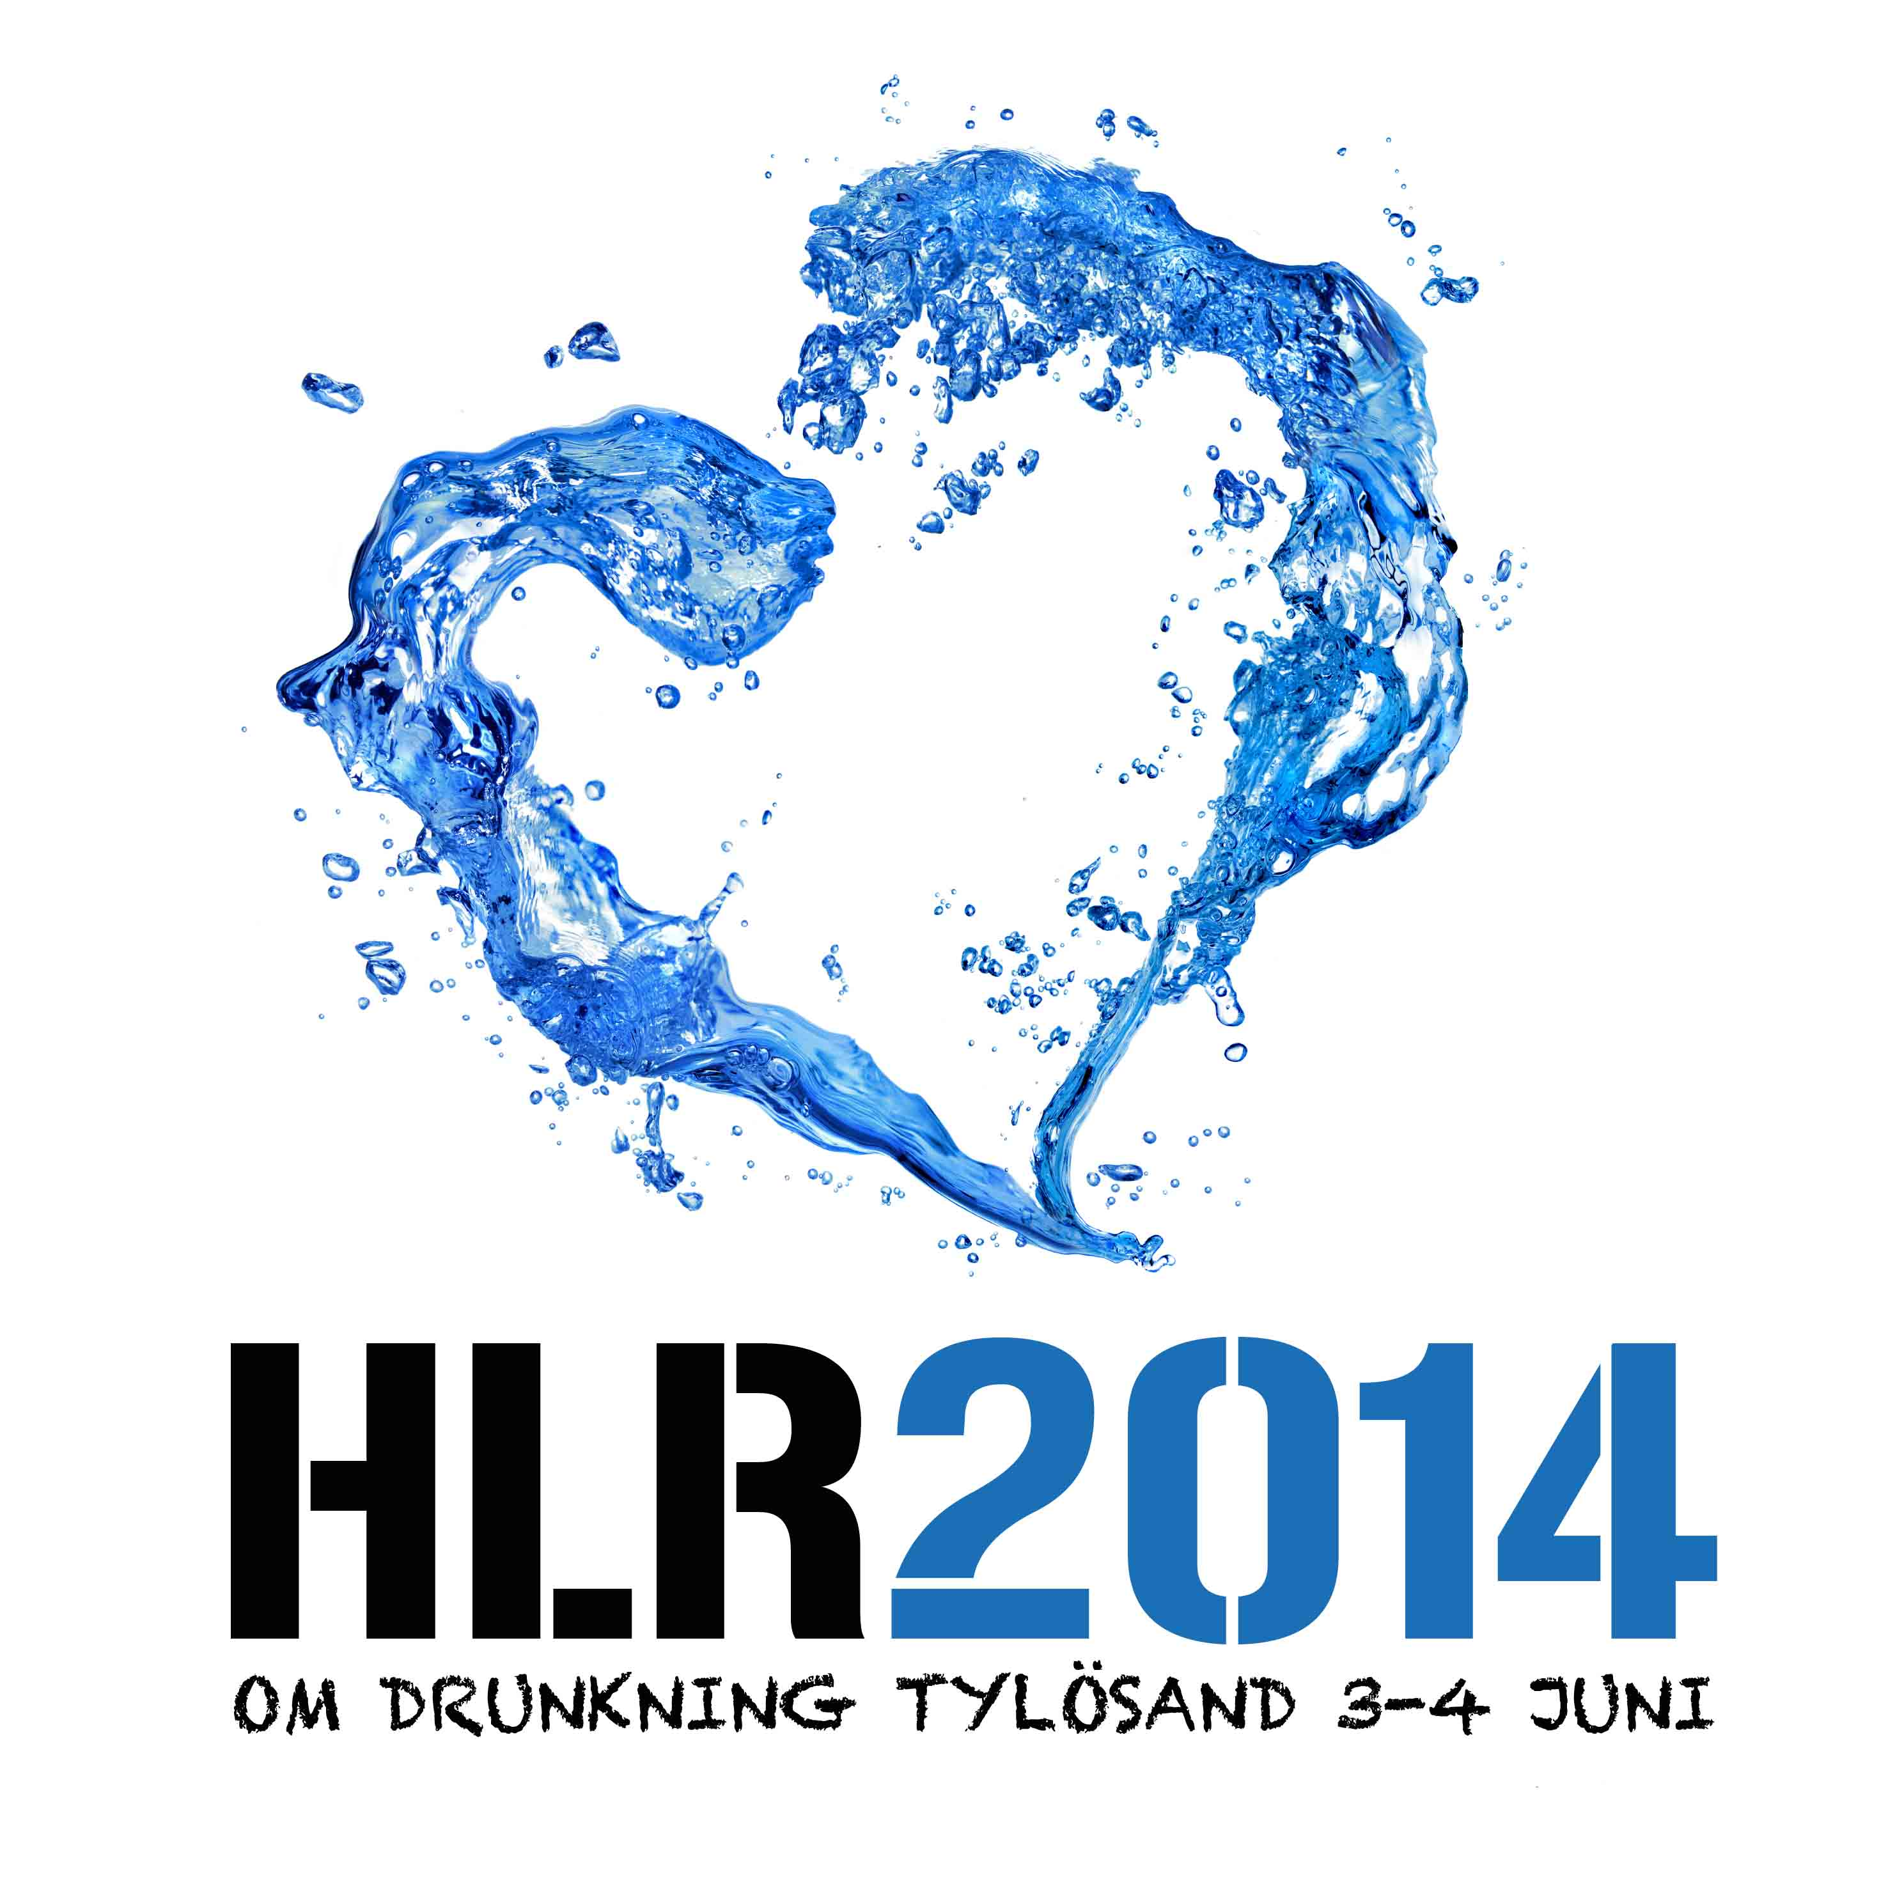


Use of Supraglottic Airway Devices in Drowning
Kasper Adelborg
MD, Senior House Officer
Department of Cardiology, Institute of Clinical Medicine
and Research Center for Emergency Medicine
Aarhus University Hospital, Denmark
Notes:
Tak for det og mange tak til arrangørerne for at have inviteret mig til dette flotte møde.
Jeg vil de næste ca. 20 min snakke om brugen af SAD’s I drukning – Hvad angår brugen af SADs er publiceret en helt del – men jeg vil forsøge at give jer en introduktion til området med fokus på drukning og brug blandt livreddere

Slide 2
Conflict of interest
None to declare

Slide 3
Background
400,000 drowning victims each year worldwide
Asphyxia ultimately causes cardiac arrest
Surf lifeguards play a crucial role
Ventilation important for the drowning victim
Quality ventilations: ↑ survival
Several ventilation devices
Notes:
Som det blev det nævnt i går er drukning et stort samfundsproblem som årligt rammer op mod ½ million mennsker
2) Asfyxia medfører respirations og I sidste ende cirkulationsstop
3) Livrederer har en vigtig rolle i first link in the chain of survival
4-5) Det er altafgørende at give effekti ventilationer og forsøge at minimerei afbrydelserne I hjertemassen.
6) Ventilation strategies, such as mouth to maouth, face-shield and bag-valve-mask have been suggested and recommended by International Resuscitation authorities

Slide 4
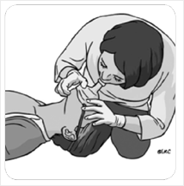
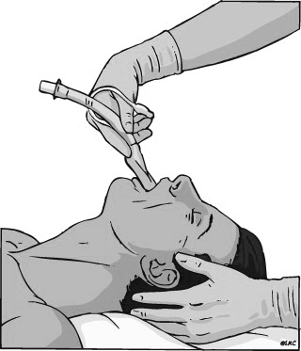
Background
Mouth-to-pocket mask
ventilation
(MPV)
Supraglottic airway +
Bag-valve mask ventilation
(SAV)
Notes:
1) I genoplivningen af druknede anbefaler International lifeguard services ife guards mouth-to-pocket mask ventilation and this will be abbreviated MPV in this presentation.
2) Et alternativ er en supraglottic airway device which is used in combination ventilationspose. This will be abbrivated SAV in this presentation

Slide 5
Notes:
This study was recently published in the journal Anaethesia

Slide 6
Aim
To compare three supraglottic airway devices on the time to ventilation and the ventilation quality of CPR among surf lifeguards
Notes:
Formål: at sammenligne 3 forskellige SAD på tiden til ventilation og kvaliteten af indblæsninger blandt livreddere.

Slide 7
Methods
Professional, surf lifeguards (> 18 years)
Recruited from 3 Lifeguard Services
Annual mandatory CPR re-training
Oral and written consent obtained
Performance not disclosed
Questionnaire – demographics
Notes:
1) Professional, paid, surf lifeguards over the age of 18 years was invited to participate in the study
2) They were recruited from 3 Lifeguard Services in Denmark
3) All lifeguards completed annual mandatory CPR re-training prior to commencing service
4) And it was voluntary to participate– and of course consent was obtained
5) The performance of the individual lifeguard was not disclosed to the lifeguard service leadership
6) All study participants completed a questionaire

Slide 8
Study design
Randomized – single rescuer – manikin
30 minutes training
Soft Seal, i-gel, AuraOnce
Insertion without and then with concurrent chest compressions
5 ventilations
Notes:
1) We randomized participants to perform single rescuer CPR on a manikin.
2) Participants were trained for half an hour to use three supraglottic airway devices:
3) Soft Seal, i-gel and AuraOnce, conforming to recognised teaching techniques.
4)After the initial training, lifeguard inserted each of the three SAD without and then with concurrent chest compressions
5) – each insertion was followed by 5 ventilations

Slide 9
Data analysis
The time to ventilation
Tidal volume
Effective breaths – visible chest rise
Air leakage
Correct use of supraglottic airways
Notes:
A few words on the data analysis.
1) The primary end-point was the time to ventilation. This was defined from participants touching the packaging of the SAD until the chest was inflated
2) Secondary end-points were ventilation quality such as tidal volume and effective ventilations
3) Effective ventilation was defined as visible chest rise and to examine this we reviewed all video recordings of the lifeguards.
4) Air leakage was recorded and was deemed present if observed by the investigators i.e. seen and/or heard in one or more of the five ventilation attempts for each SAD.
5) Concurrently we assessed whether the SADs were used correctly: gloves, cuff control, lubrication, head position, mouth insertion, pharyngeal insertion, cuff inflation and use of bag-valve mask

Slide 10
Demographics
Notes:
Characteristics of the participants included in the study is reported in this table.
Participants were approximately 25 years old,
A majority of participants was of male sex
On average participants had approximately 4 years of experience as surf lifeguard
30% was health care professionals (such as medical students, physiotherapist etc)

Slide 11
Without chest compressions
Assessed for eligibility (n=42)
Declined to participate (n=2)
Randomized (n=40)
Soft Seal - I-Gel - AuraOnce
(n=6)
AuraOnce - Soft Seal - I-Gel
(n=5)
I-Gel - Soft Seal - AuraOnce
(n=4)
Soft Seal - AuraOnce - I-Gel
(n=13)
AuraOnce - I-Gel - Soft Seal
(n=6)
I-Gel - AuraOnce - Soft Seal
(n=6)
With chest compressions
Randomized (n=40)
Soft Seal - I-Gel - AuraOnce
(n=6)
AuraOnce - Soft Seal - I-Gel
(n=5)
I-Gel - Soft Seal - AuraOnce
(n=15)
Soft Seal - AuraOnce - I-Gel
(n=2)
AuraOnce - I-Gel - Soft Seal
(n=4)
I-Gel - AuraOnce - Soft Seal
(n=8)
Notes:
This figure shows the inclusion of participants.
1) 42 were eligeble for particpation of which 2 declined to participate
2) Randomization of the 40 participants was performed in two stages.
3) Firstly each participant was randomized to insert each of the three SADs into a manikin (Ambu® Cardiac Care Trainer System, Ambu, Ballerup, Denmark) without on-going chest compressions.
4) Subsequently, each participant was randomized to insert each of the three SADs with on-going chest compressions

Slide 12
Results
Without chest compressions
With on-going chest compressions
mean±SD
34.5±6.7 s
15.6±3.4 s
35.4±8.6 s
32.9±7.2 s
15.7±3.7 s
32.5±8.8 s
Notes:
And to the results.
1) In this figure you can see times to ventilation without on-going chest compressions: I-gel was inserted and ventilations were provided within approx. 16 sec, while Soft Seal and AuraOnce was inserted witin approx. 35 sec.
2) To the right the you see the insertion times with on-going chest compressions. Although it is difficult the see from these figures, concurrent chest compressions reduced the time to ventilate by 5 (1.3-8.1) %, p = 0.0072, without differences between supraglottic airway devices, p = 0.017

Slide 13
Results
Time ratio (95% CI)
i-gel / Soft Seal
0.46 (0.44-0.48)*
i-gel / AuraOnce
0.46 (0.44-0.48)*
Soft Seal / AuraOnce
1.01 (0.97-1.06)
* p<0.0001
Notes:
This Table shows the time ratios between the SAD.
1) Så,med andre ord var tiden til ventilation med i-gel 46 (44-48) % af den tid det tog med Soft Seal and AuraOnce og det var højsignifikant p < 0.0001
2) Ingen forskel mellem Soft Seal og AuraOnce (ratio 1.01 (0.97-1.06))

Slide 14
Results
Effective ventilations
Soft Seal
i-gel
AuraOnce
100 %
*
97 %
*
92 %
* p<0.0001, Soft Seal vs AuraOnce
Notes:
This table shows the proportion of effective ventilations
1) The proportion of effective ventilations usingi-gel (97%) was not different to the other two airways, with the proportion of ventilations through the Soft Seal (100%) being more than through the AuraOnce (92%) and this difference was statistically significant.

Slide 15
Results
Supraglottic airways
Difference (95%CI)
SoftSeal/i-gel
0.12 (0.07-0.17)* L
i-gel/AuraOnce
0.11 (0.06-0.16)* L
Soft Seal/AuraOnce
0.23 (0.18- 0.28)* L
*P<0.001
mean±SD
0.65±0.14 L
0.50±0.16 L
0.39±0.19 L
Notes:
This figure shows tidal volumes using the three SAD.
1) Note that, Lifeguards only generated the recommended tidal volumes through the i-gel with a mean volume of 0.50 L
2) In the table to the right you can see that the tidal volume generated with i-gel was 0.12 (0.07-0.17) L less than through the Soft Seal (0.65±0.14 L)
and 0.11 (0.06-0.16) L more than through the AuraOnce (0.39±0.19 L), p < 0.0001

Slide 16
Results
Air leakage
Soft Seal
i-gel
AuraOnce
†
5%
†
*
23%
*
43%
* p=0.001, Soft Seal vs AuraOnce
† p=0.15, Soft Seal vs i-gel
Notes:
This table shows the degree of observed air leakage.
Air leakage, tendensen var at graden af lækage var mindre med Soft Seal (5%) end med i-gel (23%, p = 0.15),
whereas air leakage was more pronounced with AuraOnce (43%) compared to Soft Seal og this was statistically significant p = 0.001.
2) No statistitical difference between the i-gel and AuraOnce was observed..

Slide 17
Results
Participants followed recommended steps in insertion: >90%
Self-assessed skills: Insert a supraglottic airway: 100%
Self-assessed skills: Provide ventilations using a supra-glottic airway: 95%
85% preferred the i-gel - 12.5% preferring Soft Seal
Notes:
1) Finally, the majority of participants followed the recommeded steps in insertion e.g cuff control, correct head position etc.
2) All participants stated that they were able to insert a SAD (100%) and
3) Almost all participants stated that they could provide ventilations using a supraglottic airway (95%)
4) Most surf lifeguards preferred to use I-gel, whereas a minority preferred Soft Seal

Slide 18
Conclusion
i-gel is superior compared to Soft Seal and AuraOnce in significantly reducing time to ventilation
Surf lifeguards provided tidal volumes within the recommended range with i-gel only
Notes:
This study concluded that
1) I-gel is superior compared to Soft Seal and AuraOnce in significantly reducing time to ventilation
2) When using I-gel, surf lifeguards provided tidal volumes within the recommended range

Slide 19
Ventilation with i-gel™ Supraglottic Airway Compared with Mouth-to-Pocket Mask Ventilation Reduces Interruptions in Chest Compressions During Single-Rescuer Lifeguard CPR: A Randomized Simulation Study
Bo Løfgren, Kasper Adelborg, Martin Bødtker Mortensen, Lars Henrik Nielsen, Christian Dalgas, Rozh Husain Al-Mashhadi and Hans Kirkegaard
(unpublished)
Notes:
Now I will move on to another study with the title: Ventilation with i-gel Supraglottic Airway Compared with Mouth-to-Pocket Mask Ventilation Reduces Interruptions in Chest Compressions During Single-Rescuer Lifeguard CPR: A Randomized Simulation Study

Slide 20
Aim
To compare the effect of supraglottic airway ventilation and mouth-to-pocket mask ventilation on surf lifeguard CPR quality
Notes:
The aim of this study was to
1) To compare the effect of supraglottic airway ventilation and mouth-to-pocket mask ventilation on surf lifeguard CPR quality

Slide 21
Study design
Randomized – single rescuer CPR – manikin
MPV (PocketMaskTM) and SAV (i-gelTM)
Training
3 min.
CPR
5 min.
rest
3 min.
CPR
5 min.
rest
Notes:
1) We randomized participants to perform single rescuer CPR on a manikin
2) Using Mouth-to-pocket mask ventilation and Supraglottic airway ventilation using i-gel
3) Participants received initial training in using i-gel SAD and they were allowed to familiariase themselves with the MPV
4) Lifeguards performed 3 minutes of CPR – rested for 5 minutes to prevent fatique. This was repeted for each ventilation techniwue.

Slide 22
Data analysis
The first four cycles of each CPR session
Cycle excluded if participants stopped CPR
Effective breaths – visible chest rise
Notes:
A few words on the data analysis
1) The first four cycles of each CPR session were analyzed – so we looked at the first 4 sequences of chest compressions and ventilations.
2) A cycle was excluded if a lifeguard for any reason stopped CPR – for example if he/she wanted to summon the EMS or explain something or ask a question.
This was very important as not to (severely) invalidate the data on interruptions in chest compressions. To do this we reviewed all video recordings of the lifeguards.
3) As previously we used the video recordings to asses the delivery of effective ventilations - .

Slide 23
Demographics (n = 25)
Mean age ± SD (years)
25.2±4.6
Sex (n, %)
Female
9 (36%)
Male
16 (64%)
Certification year (mean ± SD)
2008±3.8
Years of experience (mean ± SD)
4.0±3.7
Health care professional (n, %)
0 (0%)
Notes:
Characteristics of the participants included in the study is reported in this table.
Participants were approximately 25 years old,
A majority of participants was of male sex
On average participants had approximately 4 years of experience as surf lifeguard
None of the participants were health care professionals (such as medical students, physiotherapist etc)

Slide 24
Results
*
* P=0.003 compared to MPV
Notes:
This figure shows the time to first ventilation attempt comparing the two ventilation techniques.
1) The time to first ventilation attempt was significant prolonged with SAV compared to MPV – however this was only approximately 3 sec.

Slide 25
Results
*
* P<0.0001 compared to MPV
Notes:
And to the results.
Firstly, this figure shows the no-flow time – in other words the interruptions I chest compressions comparing the two ventilation techniques
1) SAV significantly reduces interruptions in chest compression compared to MPV
- despite this seems as small differences – this will add up during resuscitation. This is especially the case if resuscitation is prolonged due to a remote location of a beach

Slide 26
Results
*
* P=0.04 compared to MPV.
Notes:
This figure shows tidal volumes
1) Using MPV, the delivered tidal volumes were lower compared to SAV – when using i-gel the recommed tidal volume was obtained
2) The white dotted lines marks the recommended tidal volume of 500 – 600 mL

Slide 27
Results
Notes:
This shows the results of the inspiratory time and we recorded no differences between the two ventilation techniques
The white dotted line marks the recommended time of 1 second for one rescue breath.

Slide 28
Results
Effective ventilations
MPV
SAV
*
95 %
94 %
*
Non-significant
Notes:
This table shows the proportion of effective ventilations.
1) No difference in effective ventilations (visible chest rise) were observed when comparing SAV to MPV

Slide 29
Results
Notes:
As expected we observed no differences between ventilation techniques Concerning CC rate.
The recommended CC rate is marked by the white dotted lines and and was obtained with both ventilation techniques

Slide 30
Results
Notes:
Similarly, we observed no differences between ventilation techniques concerning CC depth.
And again The recommended CC depth is marked by the white dotted lines and and was obtained with both ventilation techniques

Slide 31
Study limitations
Manikin study – e.g. no vomiting
Single rescuer scenario
No follow up data
Sizes of supraglottic airway devices
Notes:
I would like to address some of the limitations of the two studies
1) Our manikin results may not be applicable to human resuscitation. Manikins do not present with any awkward appearance such as vomiting
2) We evaluated a single-rescuer scenario because the majority of lifeguards included in our study work as single rescuers and they were trained accordingly
3) We have not assessed retention of SAD skills,
4) Different size SADs might have changed our results and we did not assess gastric insufflation, bilateral lung ventilation or peak airway pressure
Despite these limitations our data led os to conclude →

Slide 32
Conclusion
SAV reduces interruptions in chest com-pressions compared to MPV
SAV is superior to MPV in delivering the re-commended tidal volume
CPR quality is improved using SAV compared to MPV among surf lifeguards
Notes:
1) Providing ventilation using a SAD reduces interruptions in chest compressions compared to MPV
2) Ventilation using a SAD is superior to MPV in delivering the recommended tidal volume
3) Our results suggests that, CPR quality is improved when ventilations are provided using SAD compared to MPV among lifeguards

Slide 33
Notes:
Now I will move on to a third study by a german group published in Resucitation.

Slide 34
Aim
To investigate the efficacy of in-water-resuscitation during a 100m rescue manoeuvre in open water.
Notes:
The aim was to investigate the efficacy of in-water-resuscitation during a 100m rescue manoeuvre in open water.

Slide 35
Methods
Notes:
18 life guards were randomized to perform four rescue attempts
with no ventilation (NV) and transportation only;
(2) mouth-to-mouth ventilation (MMV);
(3) bag-mask ventilation (BMV);
(4) laryngeal tube ventilation (LTV)
The rescue consisted of towing a resuscitation manikin over a 100 m distance in with a backstroke swimming technique
Subjects were instructed to ventilate approximately every 10 s, i.e. to perform 6 ventilations per minute.

Slide 36
Notes:
This Table shows the results of the study and I would like to highlight a couple of the results:
1) The highest tidal volumes were achieved by MMV, while BMV resulted in too low tidal volumes. When ventilating through LT appropriate tidal volumes of 450 L was achived
2) While MMV and BMV were associated with a large amount of aspirated water, aspiration was significantly lower in laryngeal tube ventilation

Slide 37
Supraglottic airways in drowning?
- Limited evidence – lack of clinical data
- Training and retraining is mandatory
- Economical considerations
- Improve CPR quality
- Is possible in in-water-resucitation
- Reduce risk of aspiration
Notes:
The final question is – Should SAD be used in drowning by lifeguards?
On one hand the
1) Scientific evidence for using SAD among lifeguard in drowning is limited. One previous case report reported unsuccesful use of SAD in the resuscitation of a drowning victim, but more studies, especially clinical studies are needed in this area
2) SAD are implemented in a few lifeguard service, but when being implemented training, competency standards, formal theoretical and practical training courses, an instruction manual, exams, and regular re-training courses should be established.
3) The expenses for equipment i.e. SADs, training time and quality assurance required must be balanced against needs for other lifesaving equipment and training.
The possible benefits may include
Improved CPR qualily (i.e. quality ventilations and reduced no-flow time
- Is possible in in-water-resucitation
- Reduce risk of regurgitation

Slide 38
Acknowledgements
Collaborators
John Mogensen, Chief Lifeguard, North Zealand Lifeguard Service
Steve Martinussen, Chief, Copenhagen Lifeguard Service
All the surf lifeguards participating in the study
Co-Investigators
Bo Løfgren, MD, PhD
Christian Dalgas, MD
Lars Henrik Nielsen, MD
Rozh Husain Al-Mashhadi, MD
Martin Bødtker Mortensen, MD
Notes:
I would like to thank my collaborators and co-investigators – a special thank to Bo Løfgren

Slide 39
Notes:
SLUT

